Slide 1
Earning The Golden Spike
Bruce De Young, MMR
EduTRAIN™

Slide 2
By The End Of This Clinic You Will Be Able To:
Know how to earn the NMRA’s Golden Spike Award, and…
Be able to evaluate other NMRA’s member’s work and certify that they have earned the Golden Spike Award.

Slide 3
The Golden Spike Award is considered as a first step in the NMRA’s Achievement Program.
We will take a look at the exact wording of the Golden Spike’s requirements as posted on the NMRA’s website.

Slide 4
Hey, that is a lot of small print. We better break that down into bite sized bits. These are the three broad categories. We will look at each in turn.
Rolling Stock (Motive Power & Cars)
Model Railroad Setting (Structures & Scenery)
Engineering (Civil & Electrical)

Slide 5
Rolling Stock (Motive Power & Cars)
Display six (6) units of rolling stock (Scratchbuilt, craftsman, or detailed commercial kits).
Notice that the requirement is to "display" them. Nowhere does it say that they must earn a minimum number of points in judging - just that they must be displayed. ( In the monthly contests at your division meetings, for example. Even having them set out on your layout, or a table in your basement counts as "display").
These models need to show a little more effort than a "shake the box*" kit. For example, by itself a freight car kit straight out of the box, is not enough to qualify. However, by painting and decaling it, adding a little detailing, perhaps some weathering, etc., you'll have a qualifying model in no time!

Slide 6
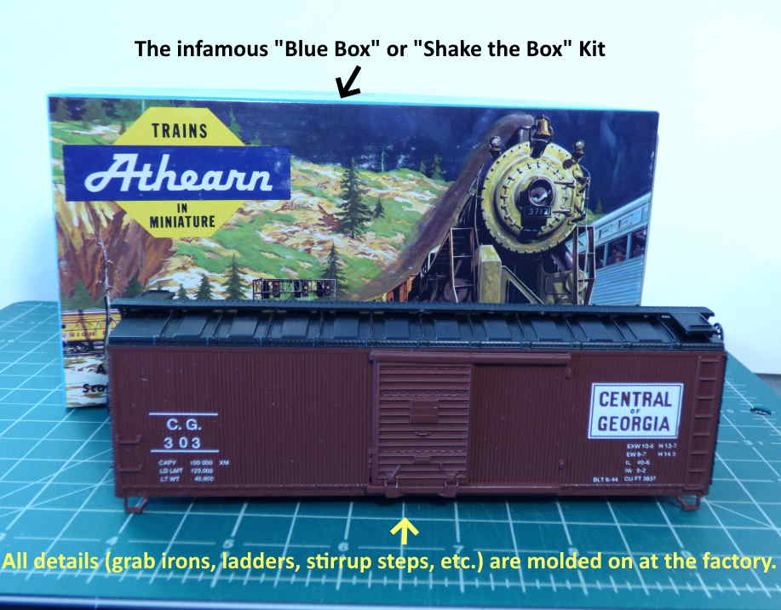
“Shake the Box*" Kit
Any kit that has molded on grab irons, ladders, stirrup steps, etc. would
fall into this category.

Slide 7
… detailed commercial kits
Let’s look a bit closer at what constitutes a “detailed commercial kit.
From the NMRA website: “These models need to show a little more effort than a "shake the box*" kit. For example, by itself a freight car kit straight out of the box, is not enough to qualify. However, by painting and decaling it, adding a little detailing, perhaps some weathering, etc., you'll have a qualifying model in no time!”
Some examples follow. As they say, a picture is worth a thousand words.

Slide 8
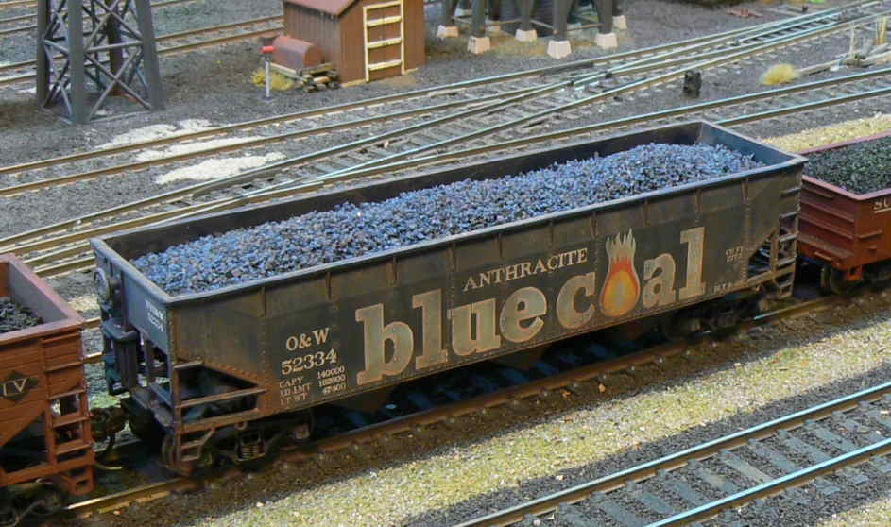
This Bowser model is certainly a “Shake the box kit”. However, make a coal load of ‘blue coal’ and weather the car, and you have one of your six pieces of rolling stock done.

Slide 9
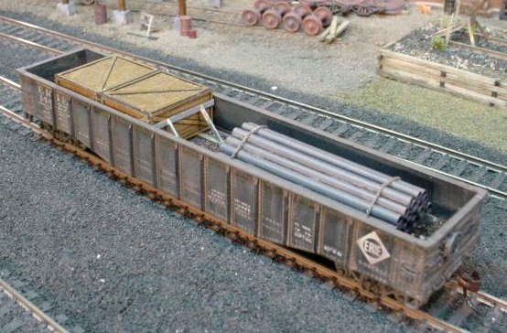
This is an Athearn blue box kit. Weather it and add a load and you are good to go. The crates are commercial laser cut items. They come flat and you have to assemble them. The pipes are coffee stirrers. The bracing on the crates and the chains on the pipe load were made by the modeler.

Slide 10
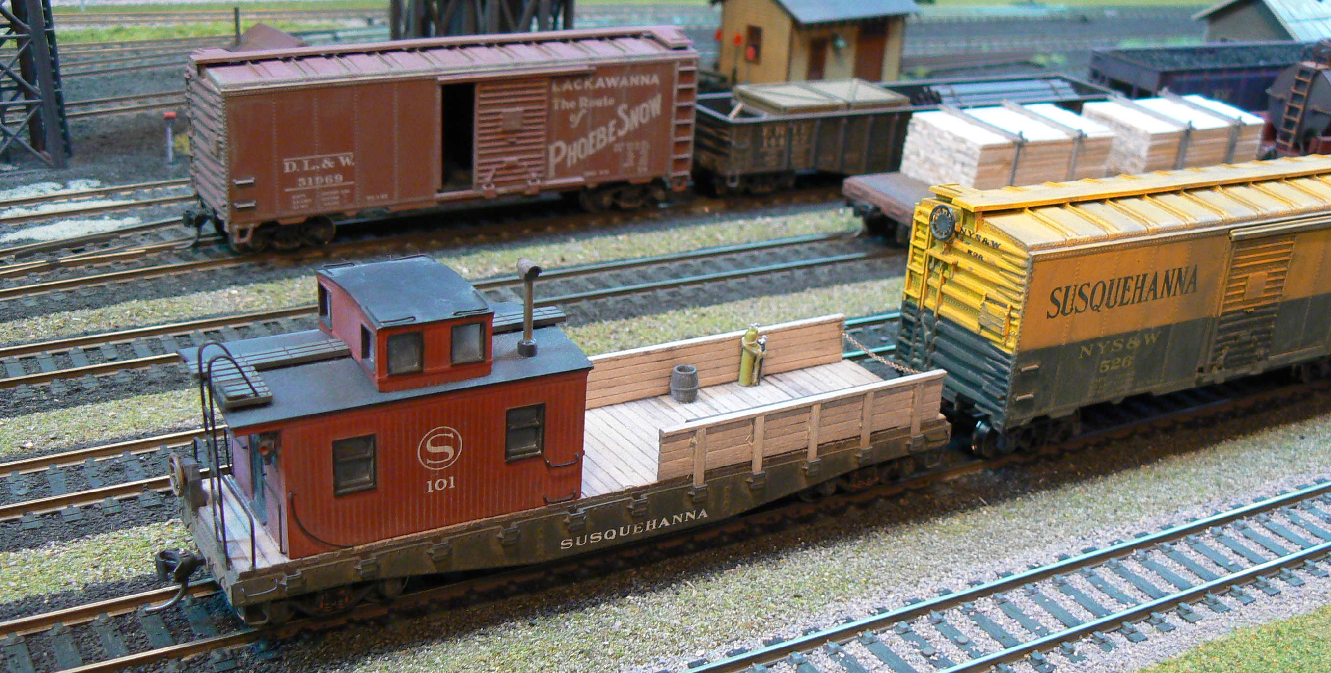
This work caboose from Athearn was an ‘undecorated’ model. It was repainted, Susquehanna decals were added, a wood deck and wood side walls were added. The roof walk is also a replacement. Another example of a “detailed commercial model”. The flat car behind the Susquehanna boxcar is another example. It was weathered and a homemade lumber load was added.

Slide 11
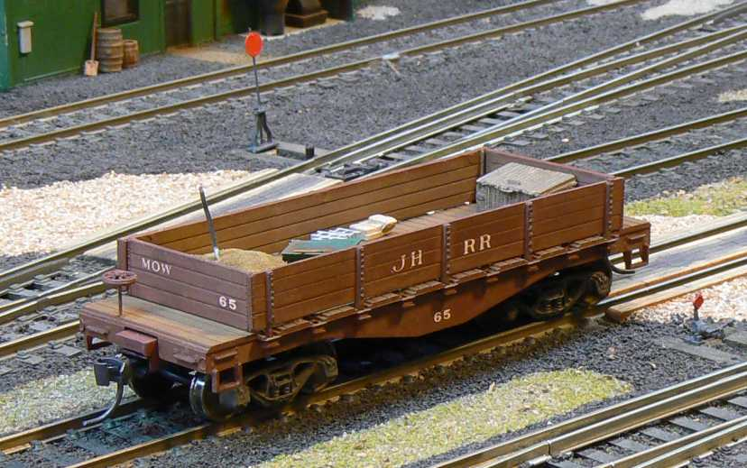
By now you know that open cars (flatcars, gondolas, hoppers) are your Golden Spike Friends. This is an Ulrich Model. Lettering this time was with dry transfer letters. It is a Maintenance of Way car with assorted masonry materials (sand, cinder blocks, shovel, cement bags, etc.) inside. Weathered, of course.

Slide 12
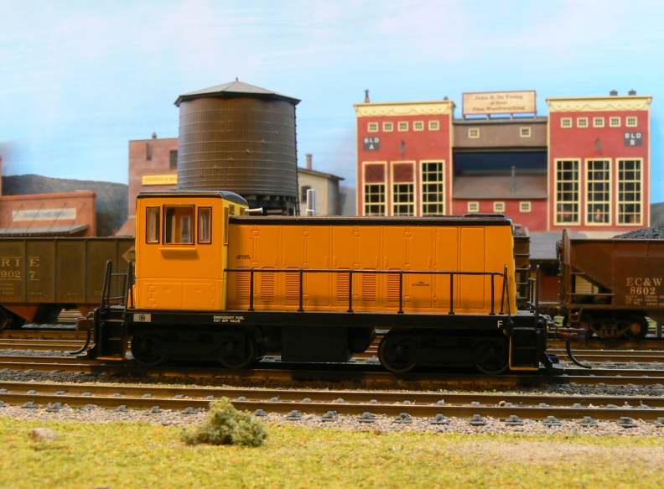
All the rolling stock could be cars, but look at some motive power, too. First up is this undecorated Bachman GE 70 Ton diesel.

Slide 13
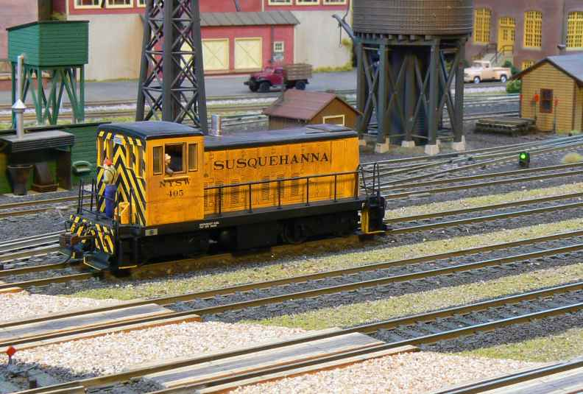
Same diesel after decals, weathering and crew were added. Ready for the Golden Spike!

Slide 14
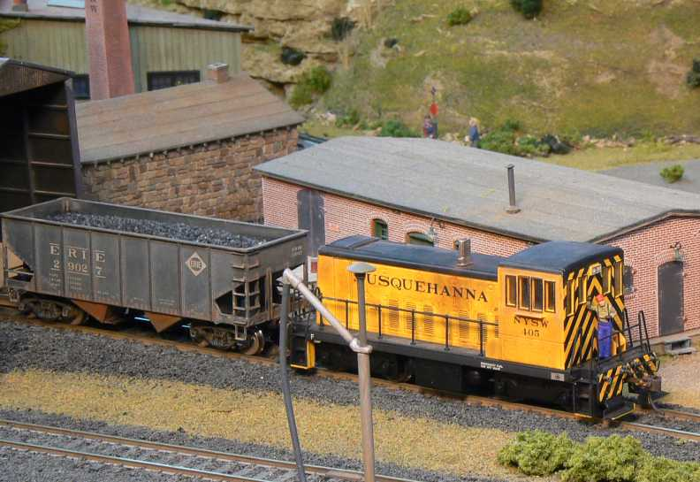
Here’s another shot of that diesel with a hopper that would also qualify.

Slide 15
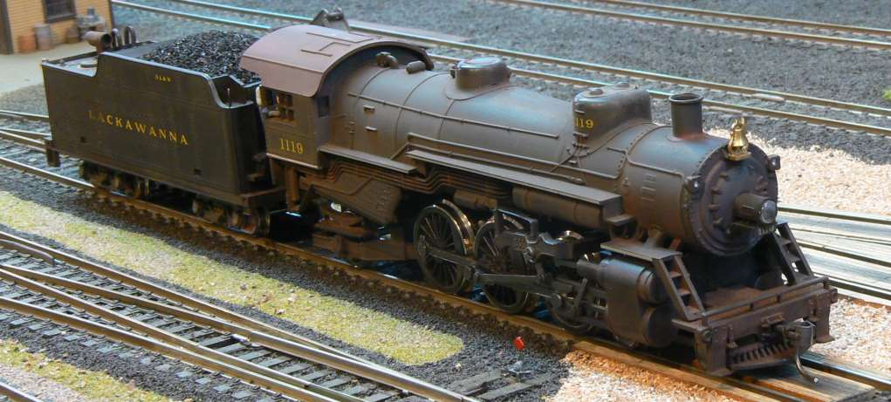
Model steam? This IHC Loco got a front coupler, a crew, weathering (including some Neolube on the drive rods.) Oh, and some ‘real’ coal in the tender.

Slide 16
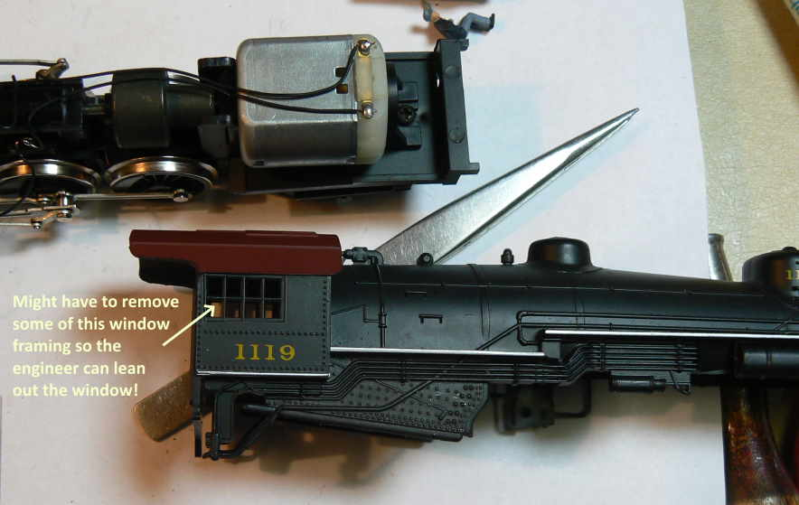
Can we please see some closeups? Sure. All shiny and new.

Slide 17
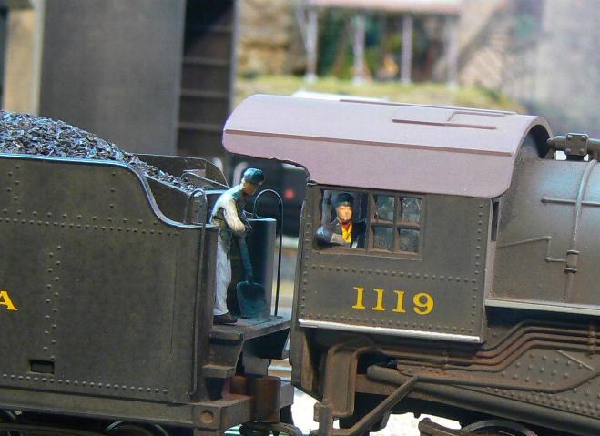
Ah, that is better. Wait a minute, is that ‘real’ coal in that tender?

Slide 18
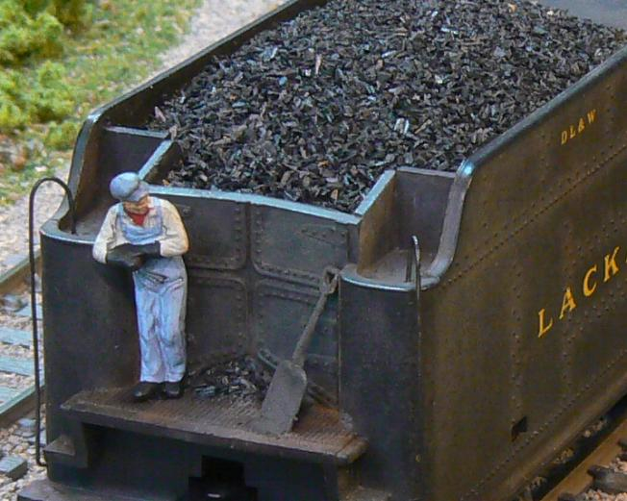
Yes, and here is a better look. None of this is difficult, folks.

Slide 19
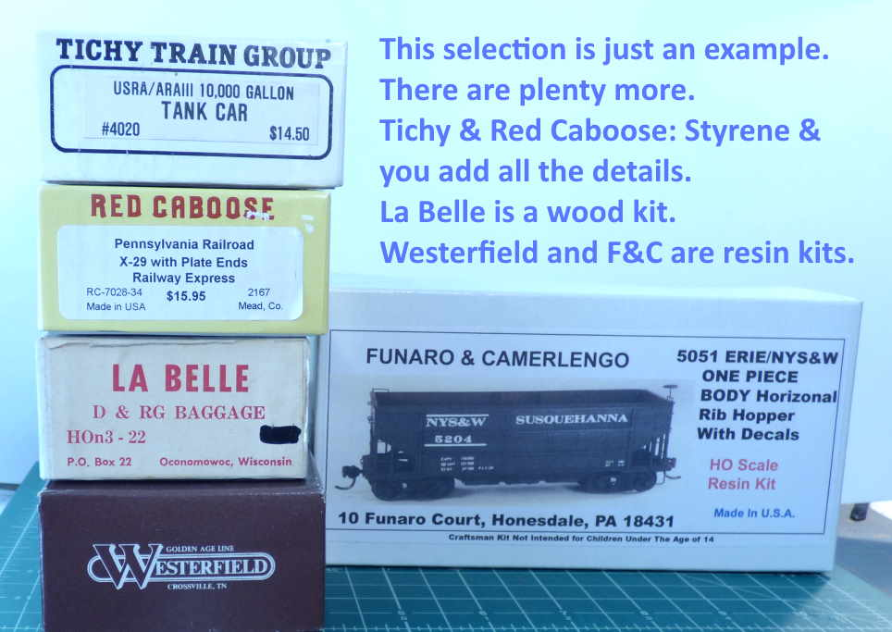
Now that we have looked at detailing “commercial kits”, there was some mention of “Craftsman Kits”. What are those?

Slide 20
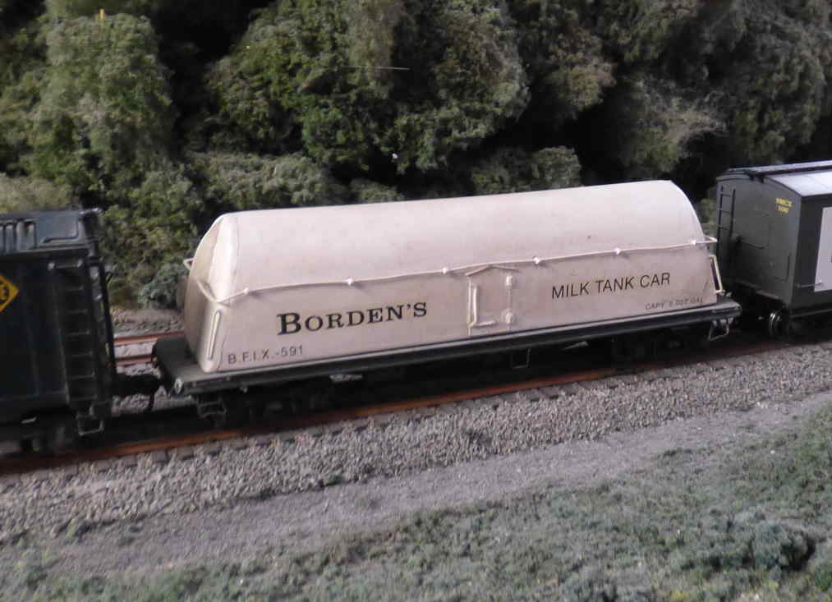
This Borden ‘Butterdish’ milk car is a resin kit from Funaro & Camerlengo. You have to paint, letter and add the details.

Slide 21
Before leaving the topic of Rolling Stock, what is this ‘scratch built’ option?
Now to be honest, few (very few) individuals earning the Golden Spike Award have used a scratch built piece of rolling stock as one of the six pieces required.
However, scratch building rolling stock is a necessary skill if you ever want to earn the “Cars Certificate” within the NMRA’s Achievement Program, so lets take a brief look at the process.

Slide 22
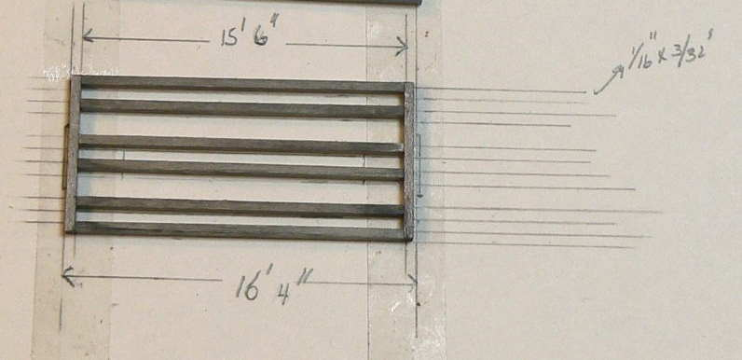
It all starts with a sketch or two. Drawing it to scale is a great idea. (This example of an HOn3 logging caboose was built by Bruce DeYoung, MMR. You can build right on top of your drawing. Here is the underframe.

Slide 23
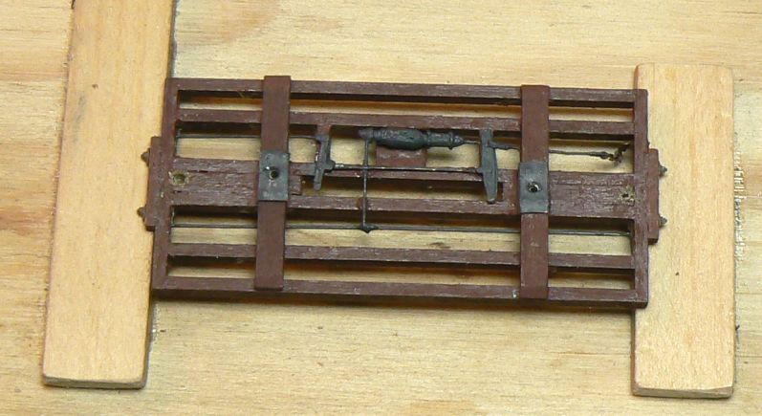
Now add the bolsters, end frame details and some basic brake rigging.

Slide 24
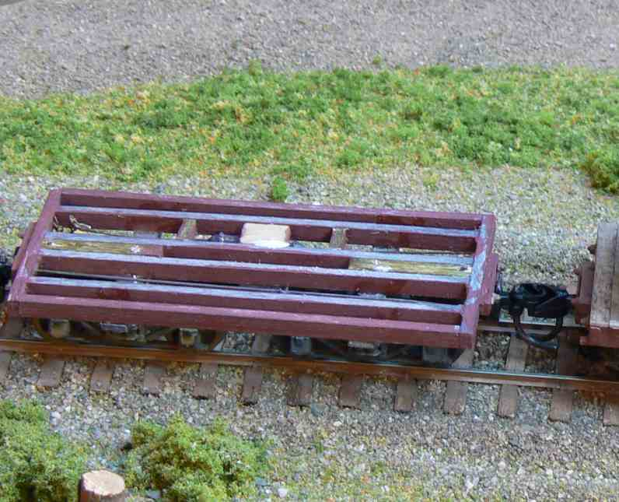
After adding the trucks and couplers, test for proper coupler height. Now time to glue on the deck boards.

Slide 25
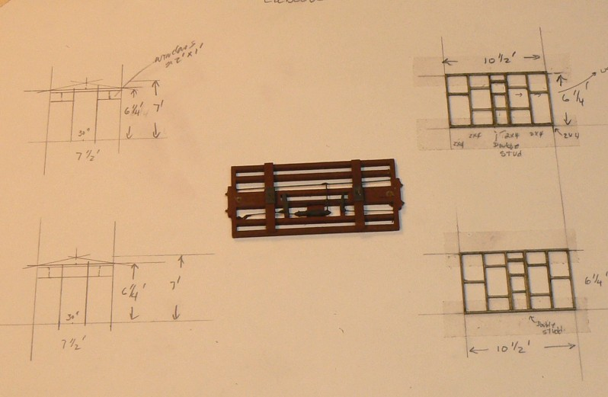
Now sketch the walls and start the framing.

Slide 26
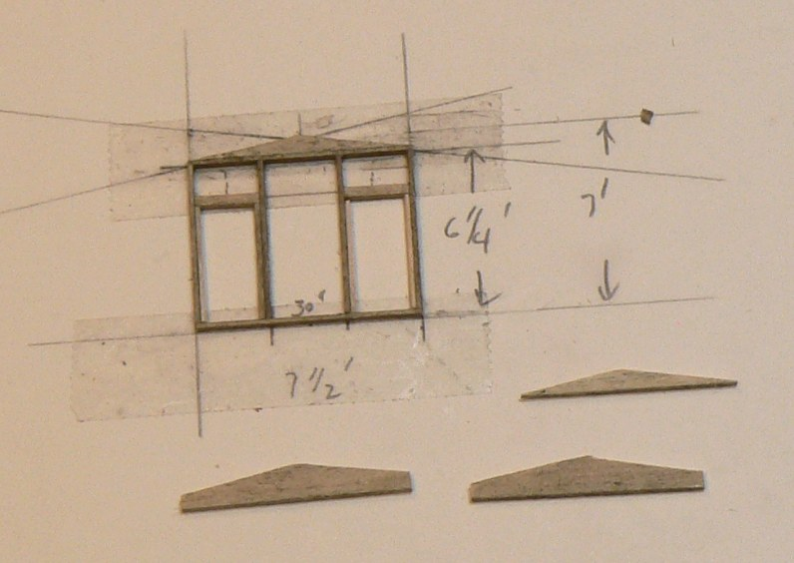
More framing.

Slide 27
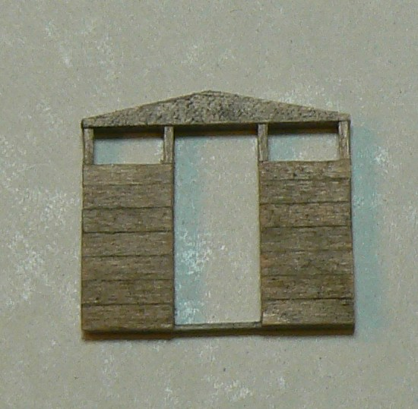
And add the wall planks. Just like building a little building.

Slide 28
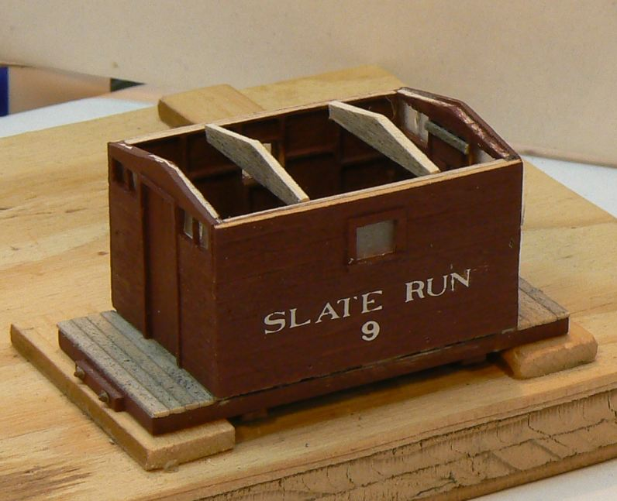
Glue the wall of the cabin together, paint and letter. The lettering here is done with dry transfer lettering.

Slide 29
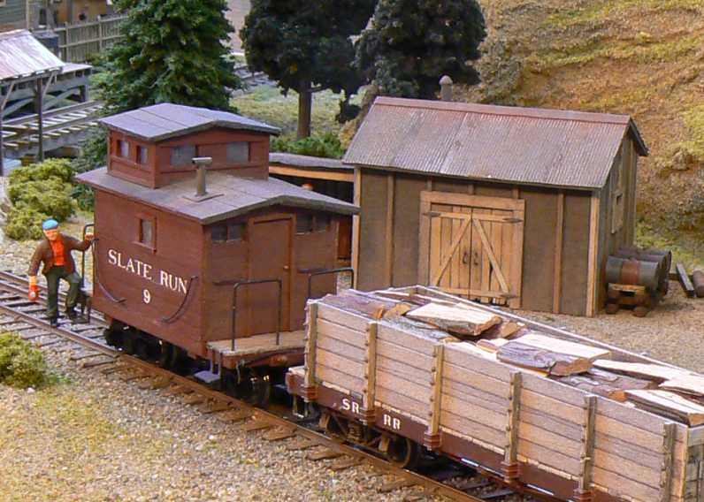
Add the roof, cupola, grab irons, steps, etc. and voila!

Slide 30
You’ve now got the information you need to get your rolling stock ready for the Golden Spike, so it is time to move on to…
Model Railroad Setting (Structures & Scenery)

Slide 31
So, what do you have to do? To start, you have to construct a minimum of eight (8) square feet of layout.
You can build your own layout
You can build a 2’ x 4’ module
You can convince a friend to allow you to build an 8 sq. ft. of her/his layout.
You can build the required size on a club layout.

Slide 32
Scenery: In your 8 square feet, we don’t want to see what is shown in the photo below. We do want:
Realistic scenery for the region modeled and the for what the scene is representing.
All track in the 8 sq. ft. must be ballasted including turnouts and other special pieces of trackwork.
Buildings should be ‘planted’ in the scenery.
Notes:
When we say that a building should be planted in the scenery we mean that we should not see ‘air space’ under the building. The landscaping around the building should hid all that.

Slide 33
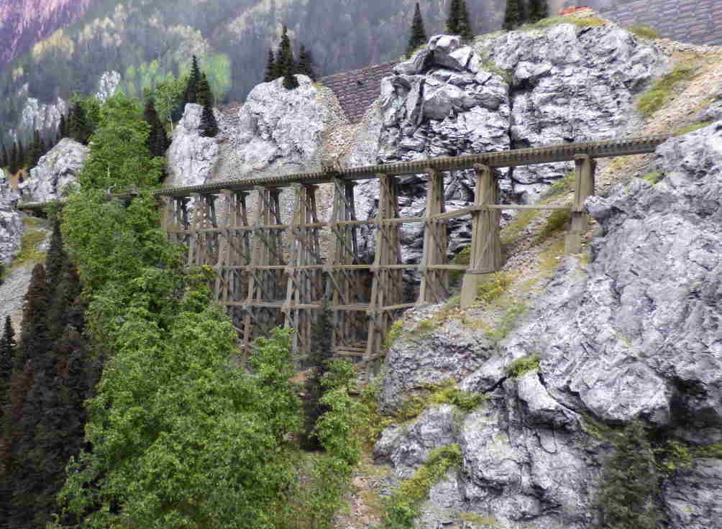
You do not need to model a mountain scene with terrific plaster rock work – but you could.
Notes:
Bob Hamm’s D&RGW HOn3

Slide 34
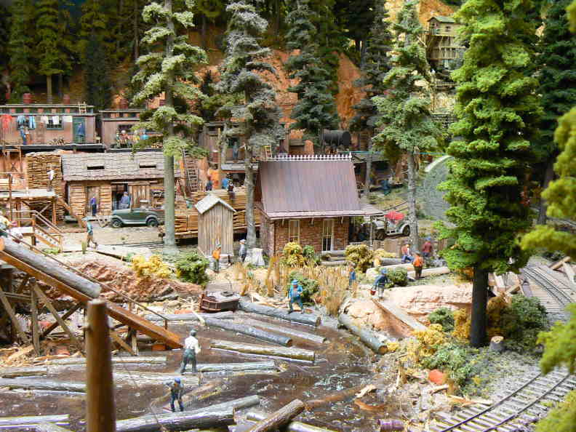
You don’t need to make your own trees or model some water – but you could.
Notes:
Doc Patti’s On3 Winged Foot and Western RR.

Slide 35
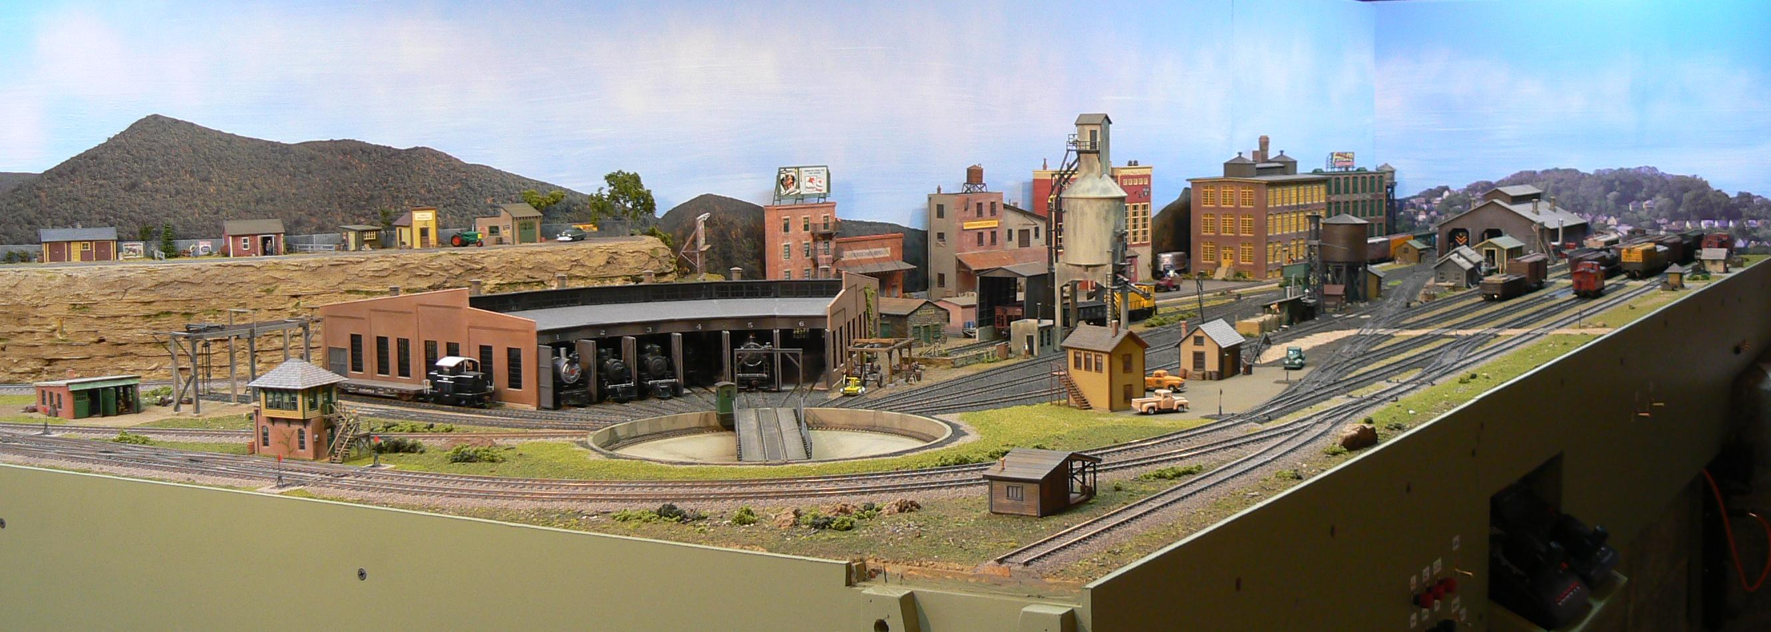
In fact, this yard area earned both the Golden Spike and the AP Scenery Certificates. Notice any trees or water?
Notes:
Although most of the trackage in the yard is not laid on contoured roadbed, the double tracked curve and stub siding in the foreground is on cork roadbed.

Slide 36
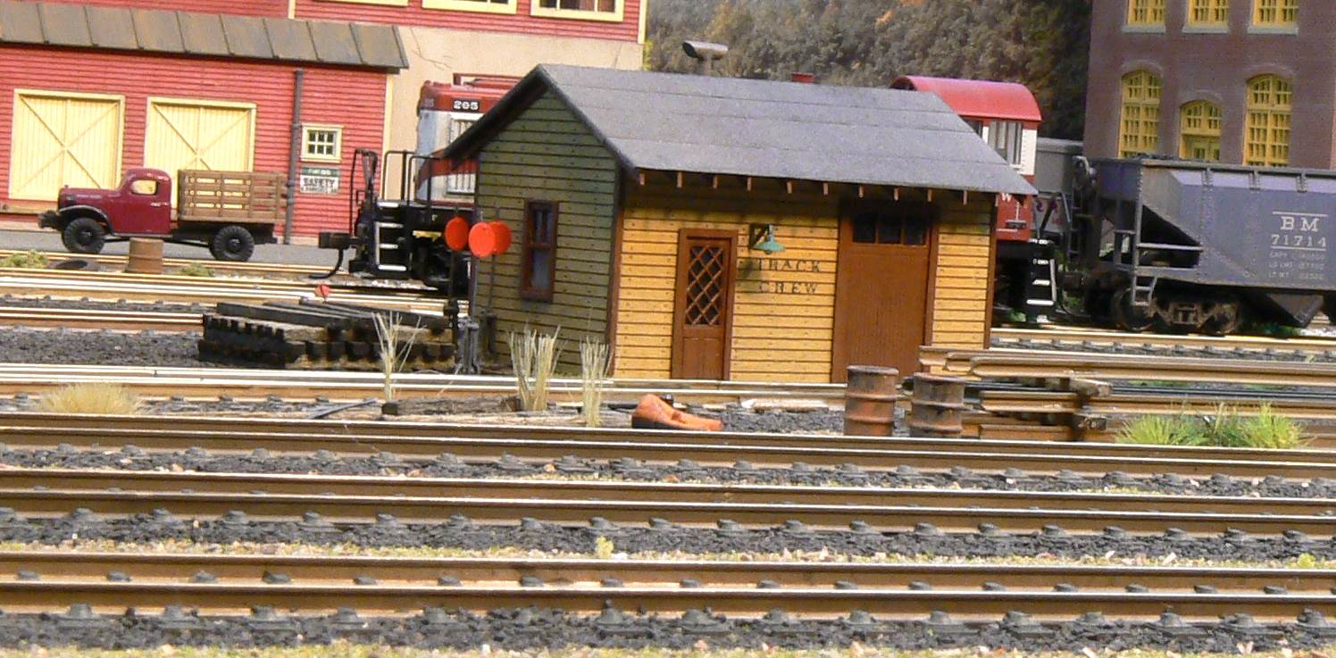
Let’s take a closer look. Cinder ballast, some ‘burnt’ grass, weeds, detail items found in yards, etc.

Slide 37
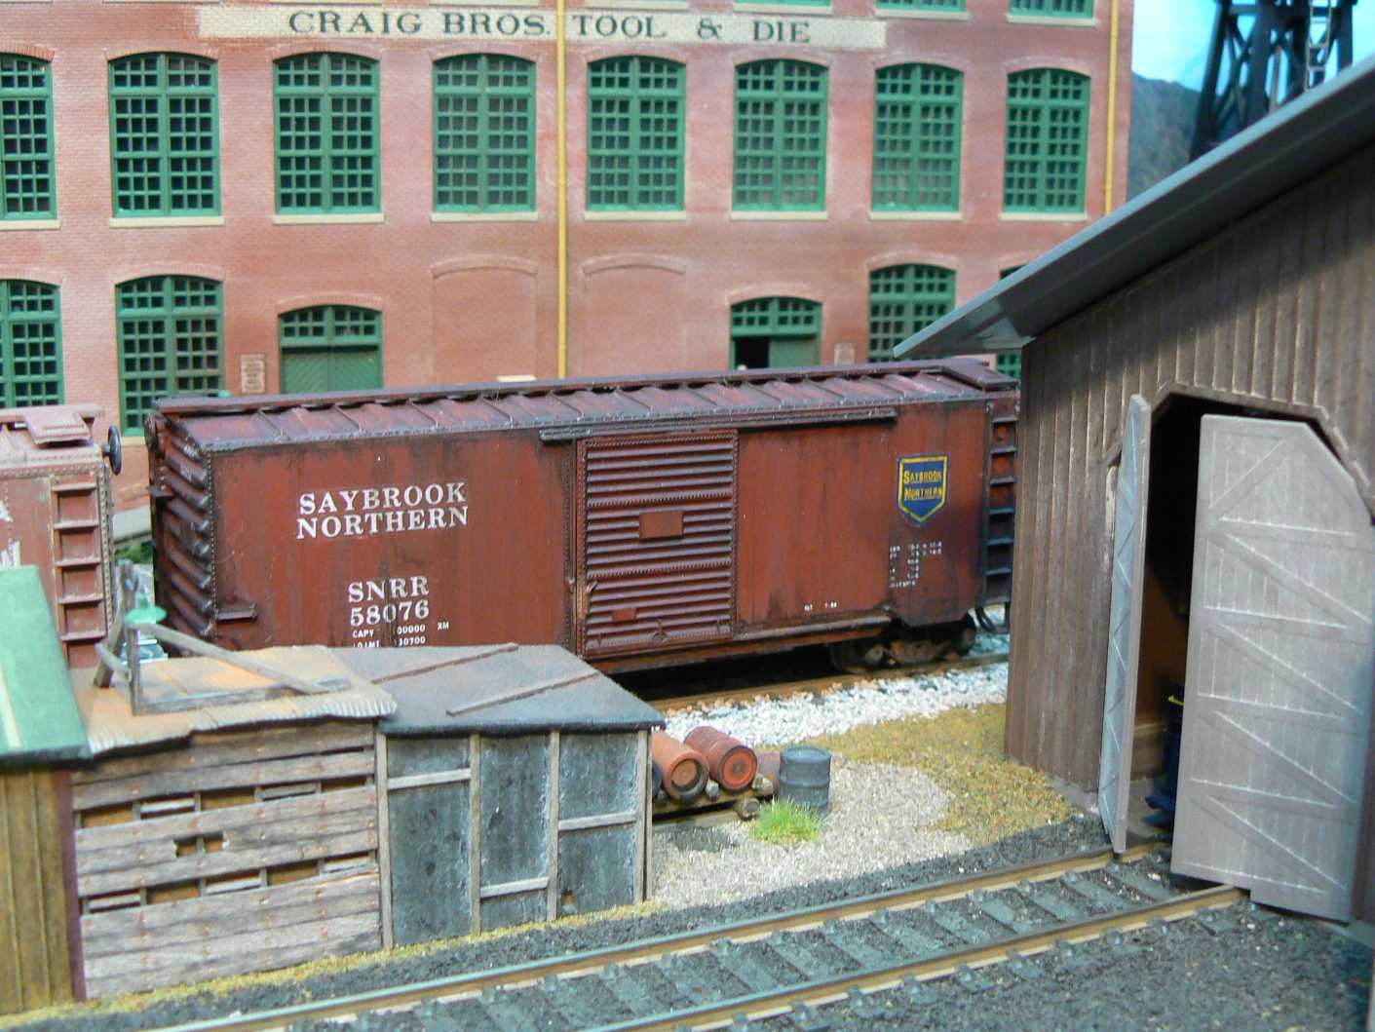
Here is another scene from the yard.

Slide 38
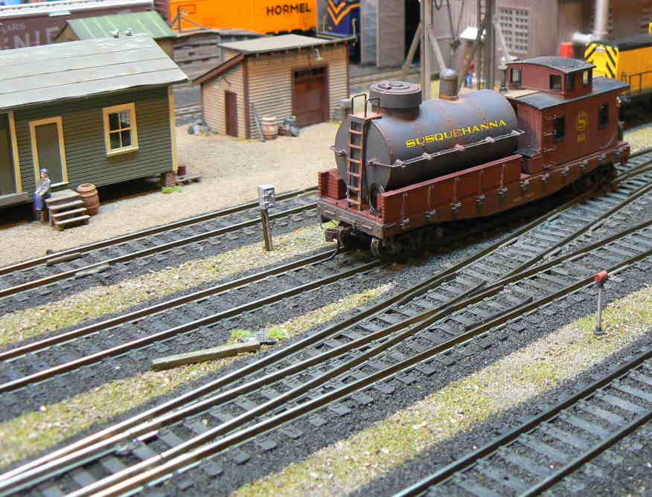
Plywood base painted an earth color. A thin layer of diluted white glue with either dirt or Woodland Scenics Burnt Grass sifted in. Ballast last.

Slide 39
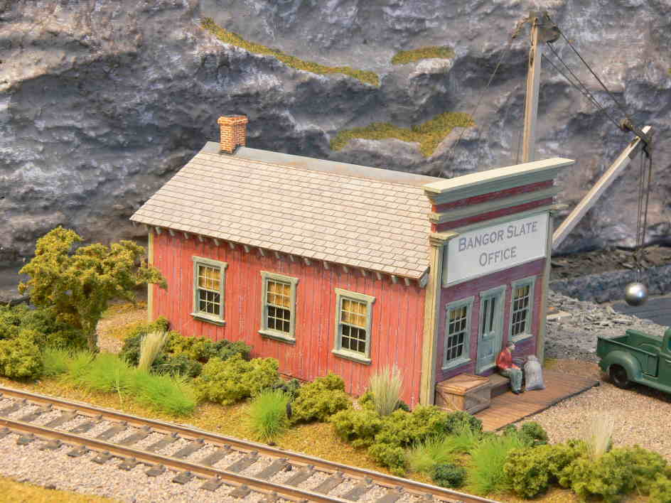
Here is a scene away from the yard. Contoured roadbed, more greenery.

Slide 40
Structures
Construct five (5) structures (scratchbuilt, craftsman, or detailed and commercial kits). These structures may be separate, or one or more of them may be part of a single scene.
We just saw this wording for rolling stock. Let’s see some examples with structures.
Remember that "structures" aren't just buildings. Things like bridges and trestles also fall into this category.
Basically, in the Golden Spike, we are looking for use of some modeling skills beyond gluing.

Slide 41
Question: There are some beautiful Pre-Built and nicely details Structures. Could one of those be used as one of the 5 Structures?
Ans: Stop pulling my leg!
We are looking for a demonstration of some modeling skills – not examples of nice structures.

Slide 42
I built a nice plastic kit. Looks good. Does it count?

Slide 43
You know the answer unless…
Did you re-paint the walls? And/or,
Did you weather the walls and roof? And/or,
Did you make your own sign for the structure? And/or
Did you add some details to that loading dock? And/or
Did you modify the structure or add to it in some way?

Slide 44
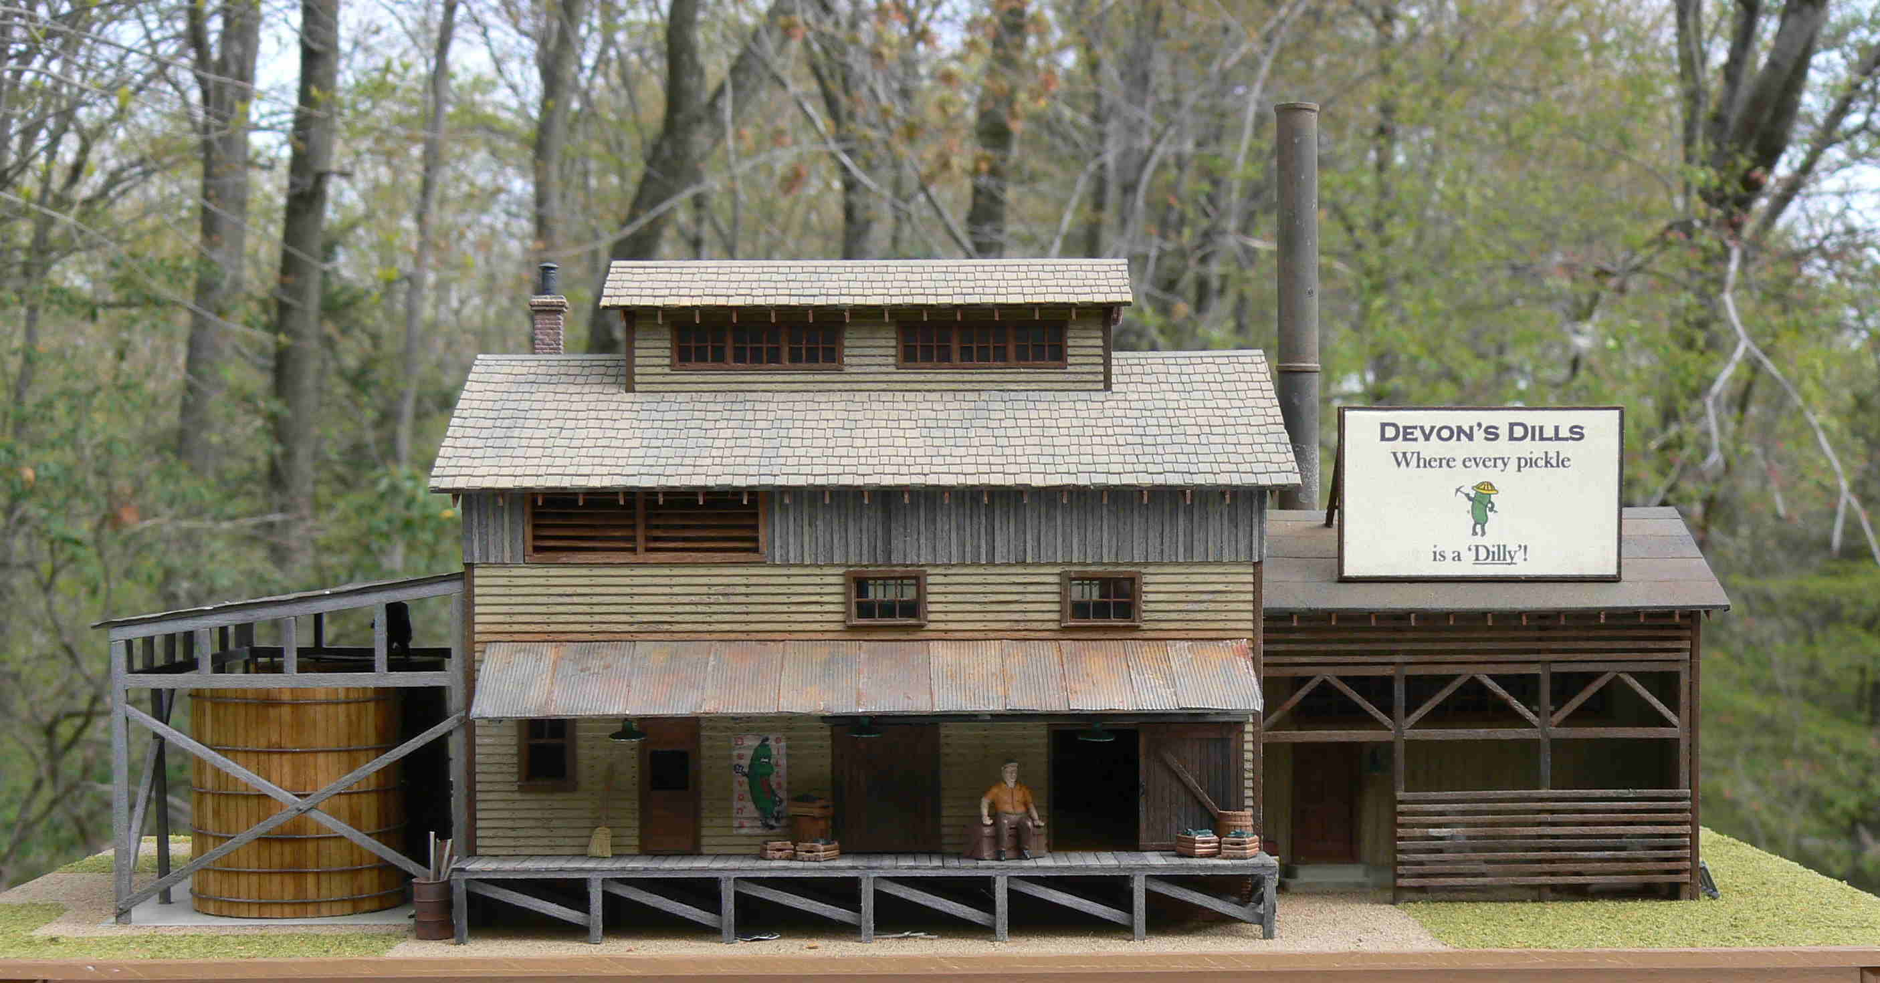
Or, you could just scratch build that pickle factory out of wood.
Notes:
This is a completely scratch built structure made of wood. In this case the builder had the plastic kit on hand and took all the dimensions right from the kit walls.

Slide 45
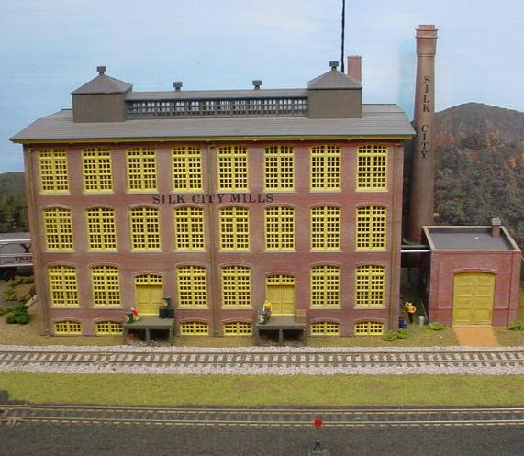
Here is a Walthers styrene kit. The walls have been given a wash to add mortar to the bricks, a name has been added using dry transfers, some details have been added to the loading docks, a boiler house and smoke stack has been added to the structure. It would count.

Slide 46
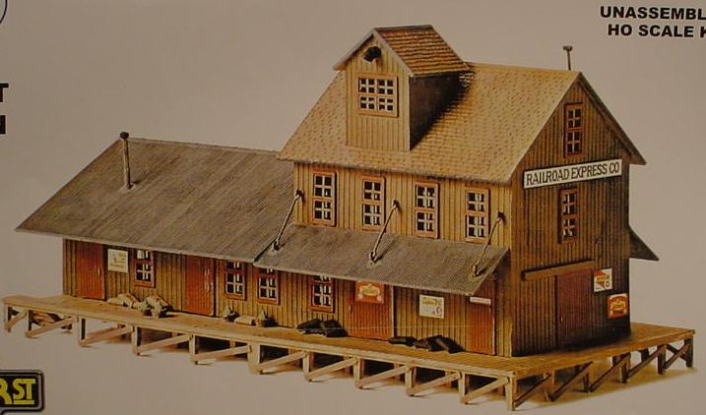
This styrene model is found on many layouts. Let’s see what some modelers have done with it.
Notes:
Of course, the model does not come out of the box colored like that. Depending on which company owned the moulds at the time, it was usually made with either yellow or green walls. No signs were included with the kit.

Slide 47
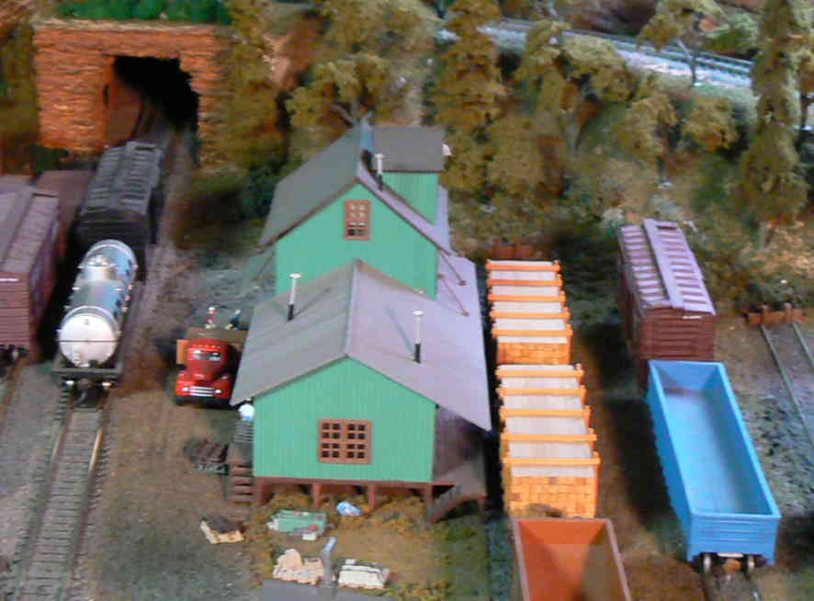
As built, right out of the box. (Would not qualify for the Golden Spike.)
Notes:
Notice that there is no glazing on the windows. You can see that the entire building is up on those ‘legs’. Notice too, the longer overhang on the right side of the structure – that is the front of the building. We will se another example where the modeler cut that roofline beck to match the other side.

Slide 48
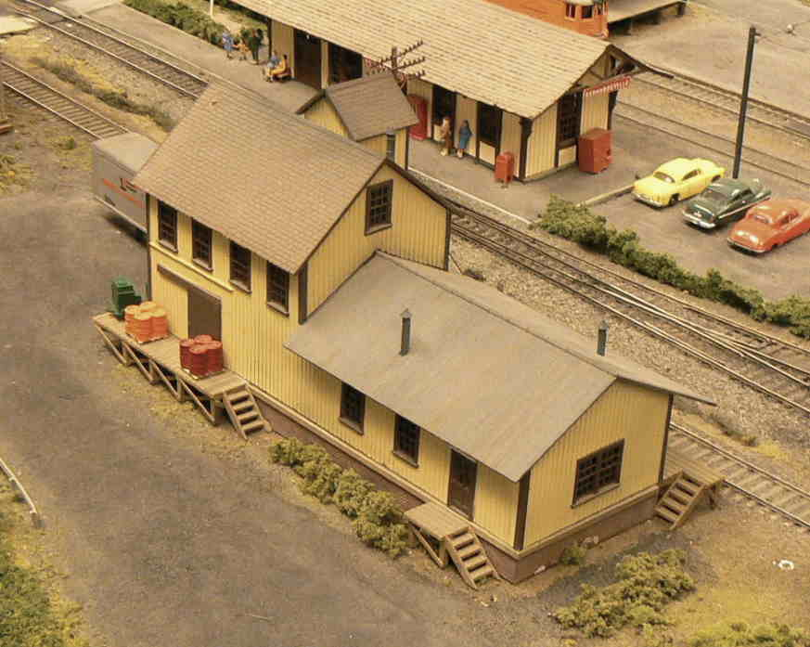
This is an O-Scale version of the building. It has been painted and a foundation has been added underneath. This would qualify for the Golden Spike.

Slide 49
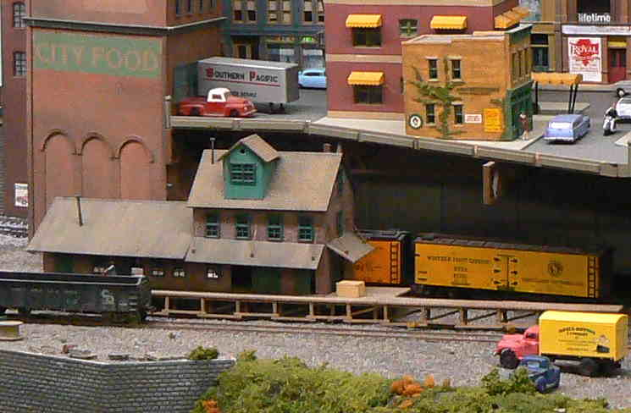
You can see that the walls have been re-painted (except for the dog house), a new loading dock has been built, weathering has been added. Good for Golden Spike.

Slide 50
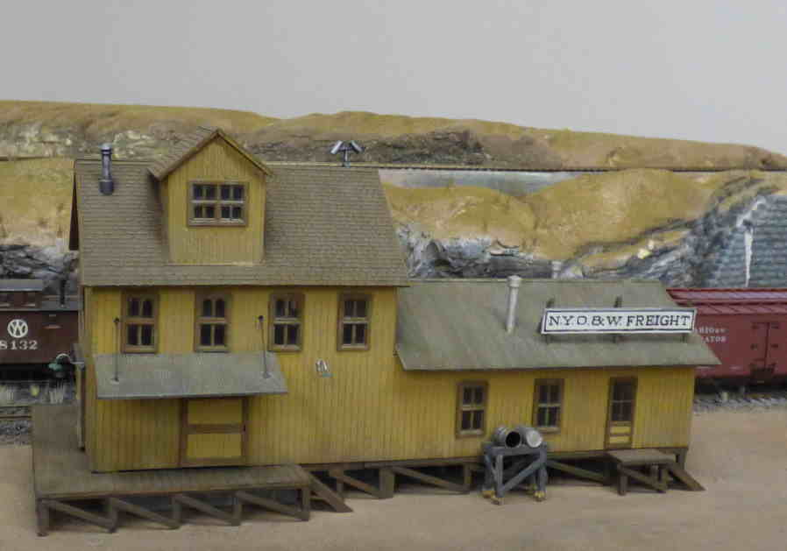
Painted, weathered, new sign. Sad that the loading dock is empty and there is no glazing in the window. Borderline okay.

Slide 51
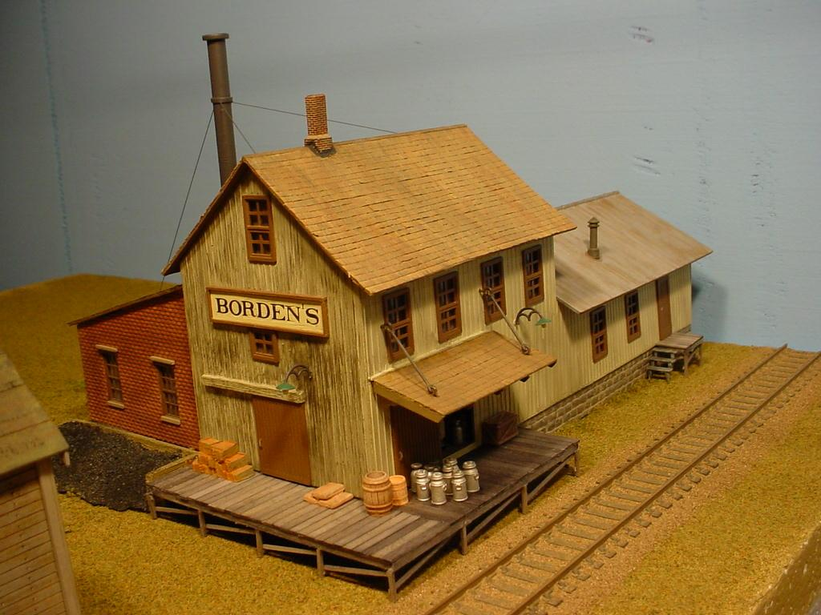
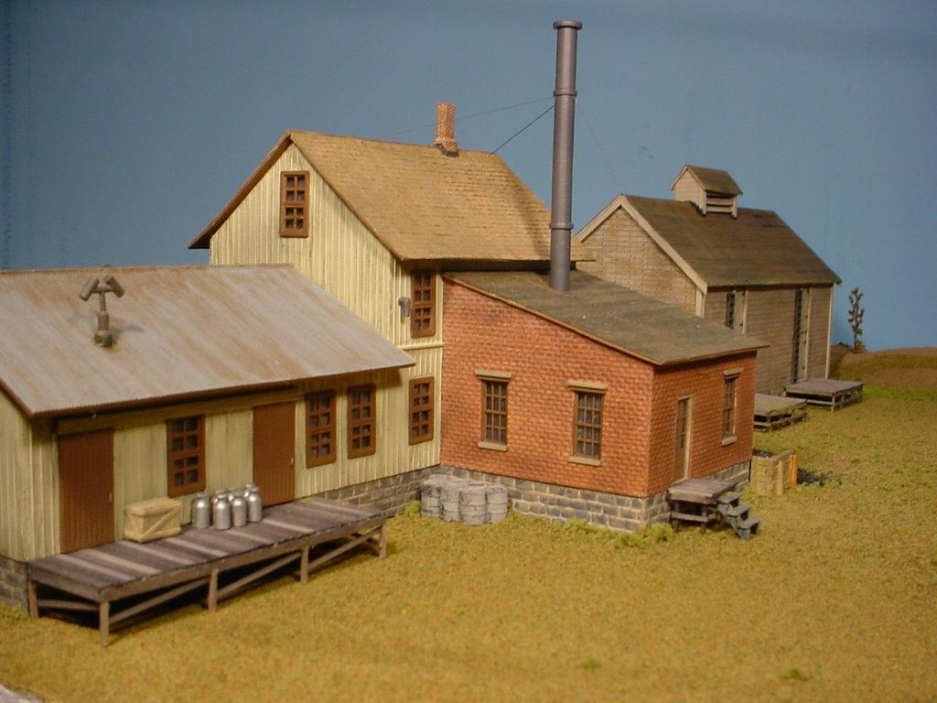
Almost hard to recognize it as the same structure. Definitely good for Golden Spike! New roof on tall part, cut back the overhang on lower roof, boiler house addition, foundation, wood loading docks, etc.
Notes:
No longer a freight house. We now have a creamery.

Slide 52
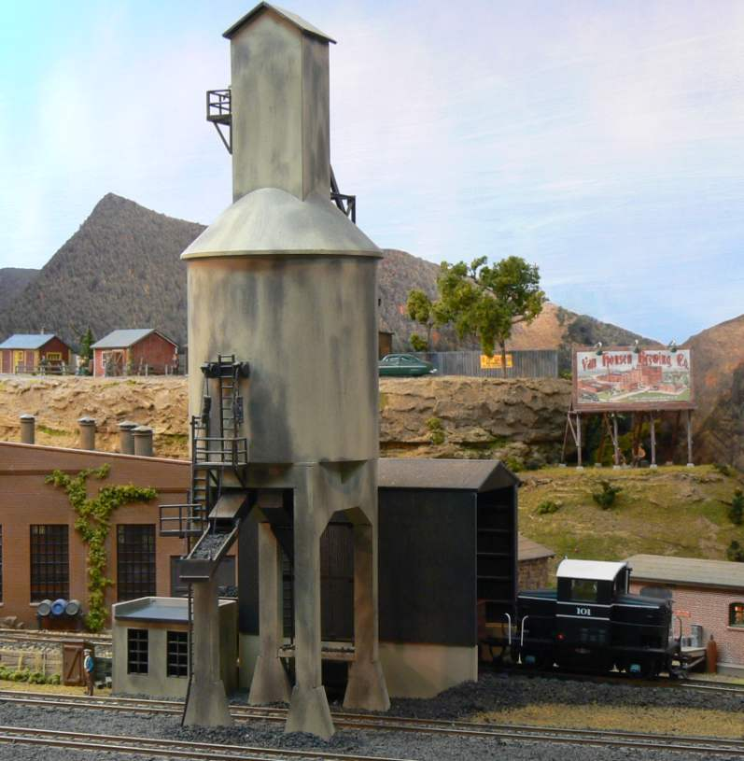
This Styrene Coal Tower Is Painted, Weathered, and Coal Has Been Added To The Chute. It Qualifies.

Slide 53
Summary ideas for “upgrading” styrene kits
Paint the walls, roof and windows
Weather the model
Change the roof line
Add a foundation
Change the roof material
Add a porch, deck, or loading dock
Put an addition on the structure
Add interior and/or exterior details

Slide 54
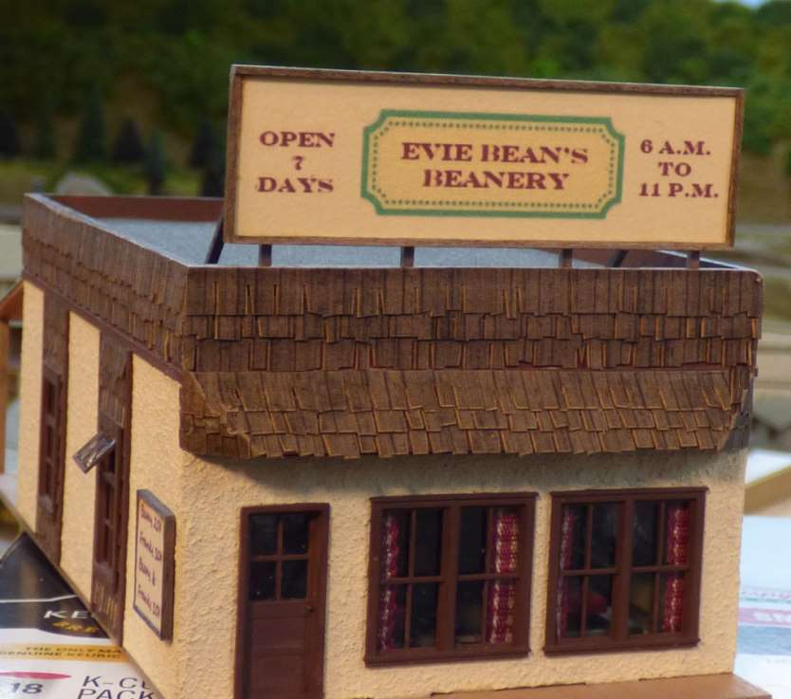
Almost any wood structure kit will count because you have to paint the walls, add you own roof shingles, and other details. Add a sign and a little weathering and you are good.
Notes:
Here the roof sign is home made on the computer and printed out. Drapes made out of decorative ribbon have been added to the front windows. One side window has been modeled open.

Slide 55
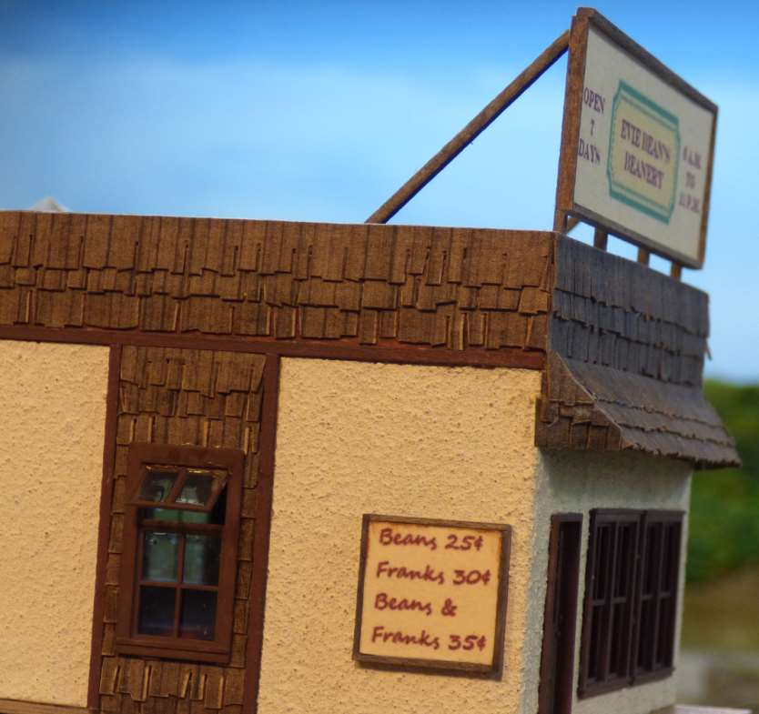
Another home made sign.
Notes:
Oh, and that stucco is simply a textured paint that you can buy in any craft store.

Slide 56
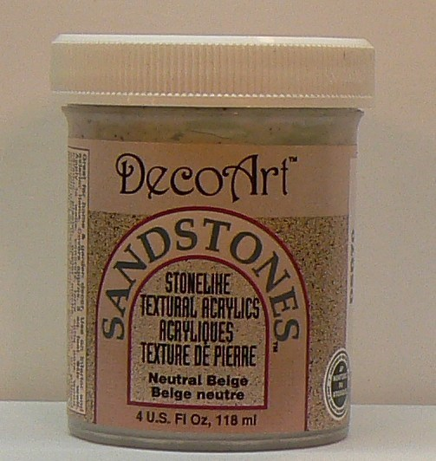
Notes:
This is the textured paint that was used on the walls of the Beanery.

Slide 57
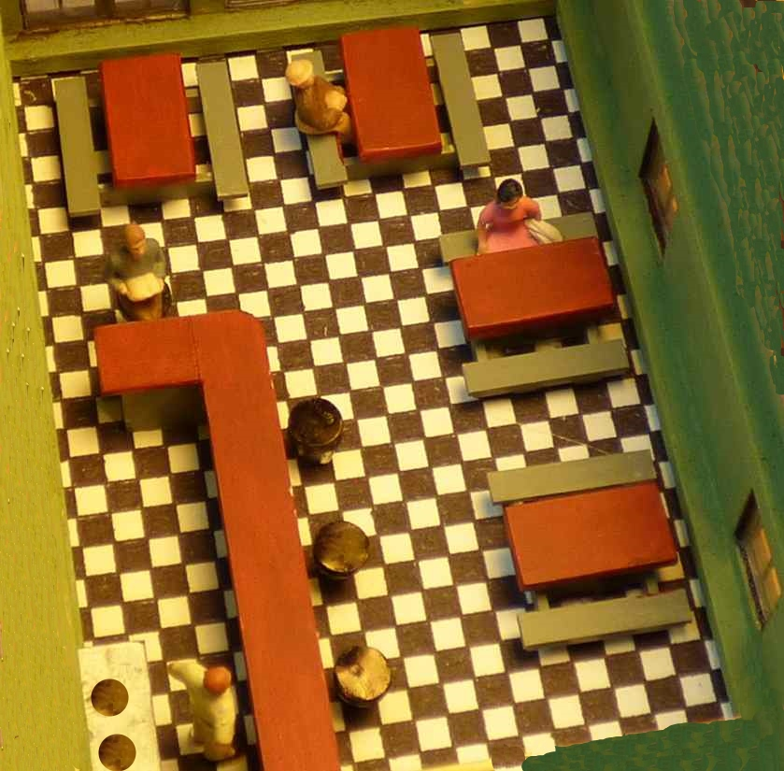
Although not necessary, a simple interior has been added (only seen thru the windows).
Notes:
The flooring could be a picture taken from the internet, but this one was a piece of graph paper with staggered squares colored black with a fine black Sharpie. The stove, counter and tables were quickly made from styrene and painted.

Slide 58
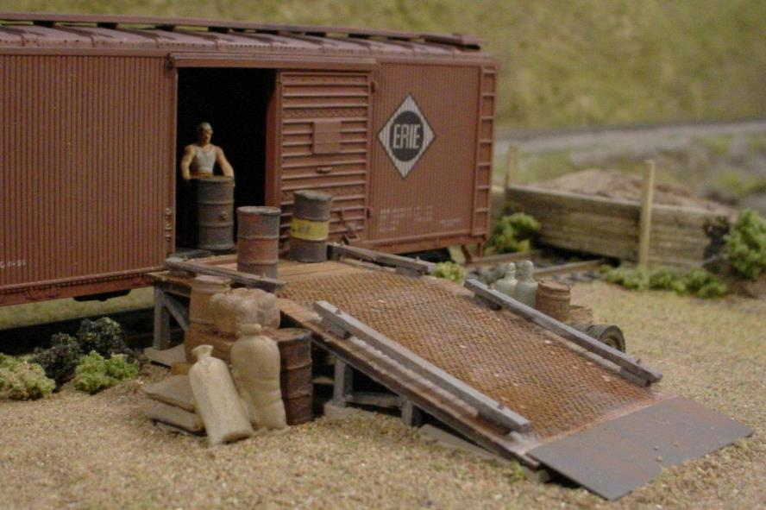
Want something even simpler?
Notes:
This wood loading ramp kit requires staining the wood, cutting it to size, gluing it together, painting the anti-skid mat, the NBW castings, and the metal edge to the bottom of the ramp. Once painted , they have to be added to the model. You have just demonstrated quite a few modeling skills on a very simple model.

Slide 59
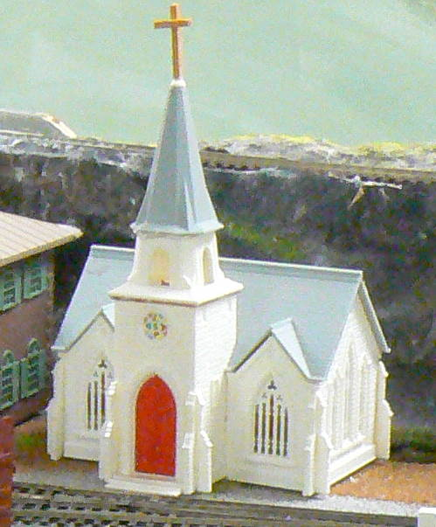
Nice Church. What Do You Think?
Notes:
Okay, this is not rocket science. Let’s move on to trackwork and electrical. (This kit was built ‘as is’ – no painting, weathering or added details. This would not qualify for the Golden Spike.)

Slide 60
Engineering (Civil & Electrical)
Three (3) types of trackage are required (turnout, crossing, etc.)
All must be properly ballasted and installed on proper roadbed.
Commercial trackage may be used.
"Types of trackage" can be just about anything: turnouts, crossings, and grade elevation (a change in elevation of the track) are all examples of "types of trackage".
Also, note that the three types DO NOT have to be different. For example, just having three simple turnouts will qualify.

Slide 61
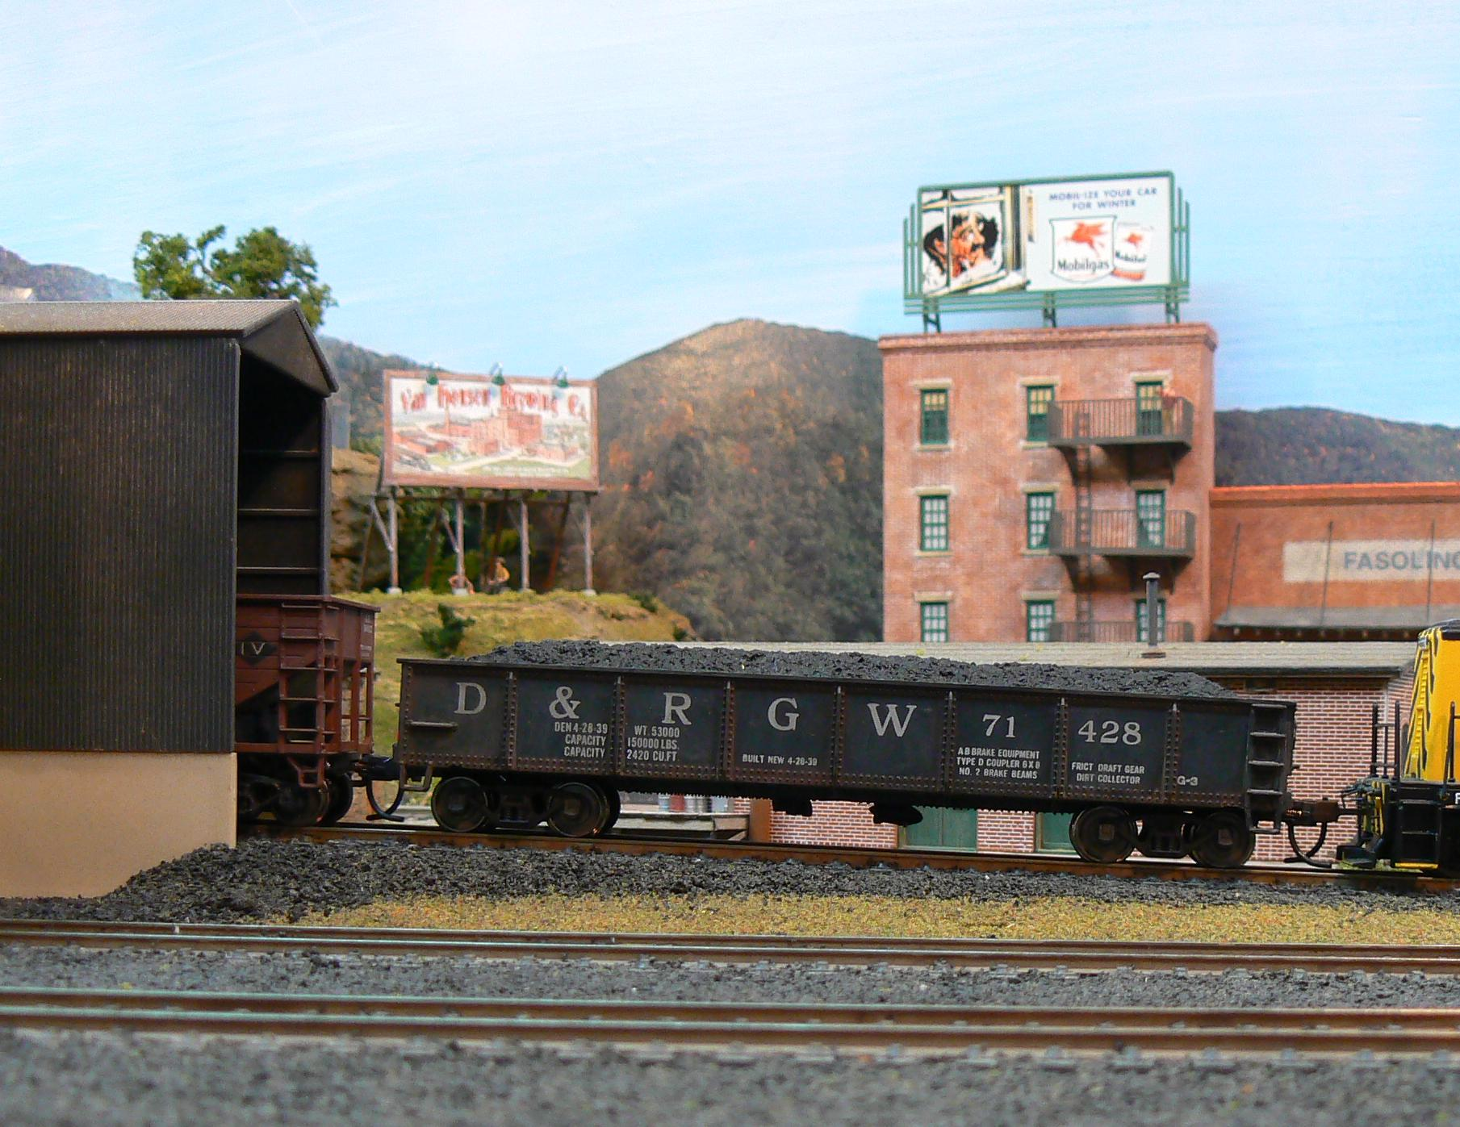
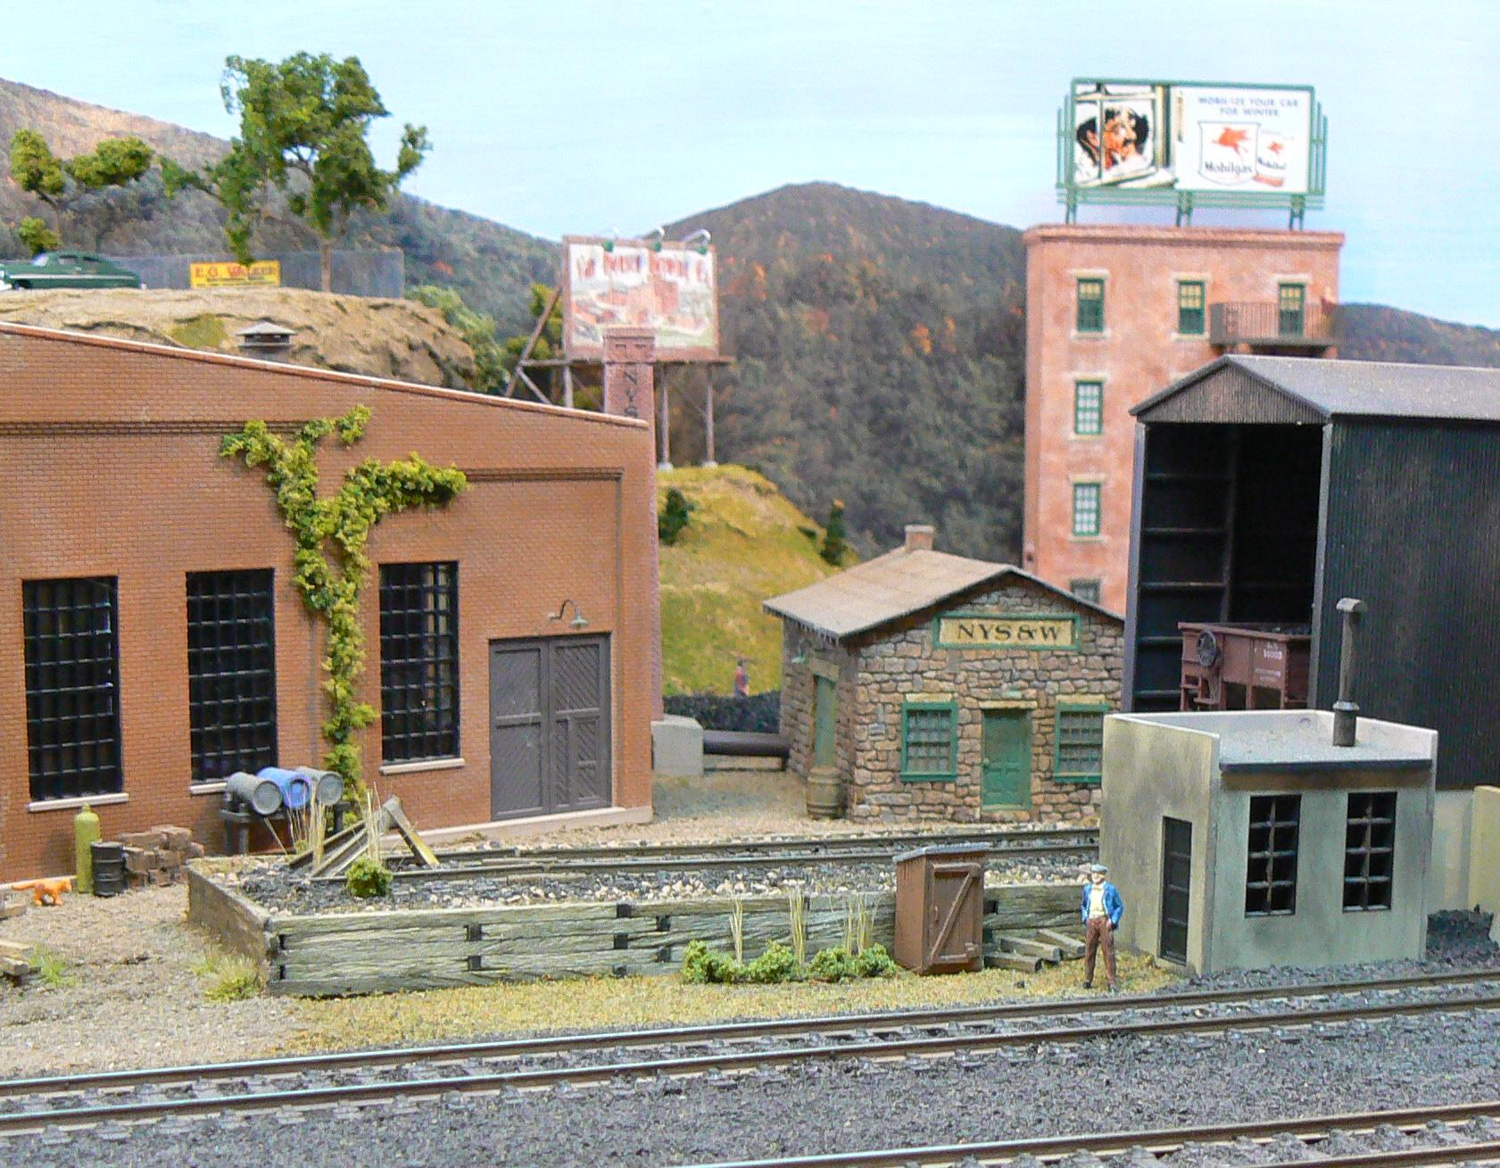
Let’s Look At Some Pictures This incline up to a coal dump satisfies “a change in elevation”

Slide 62
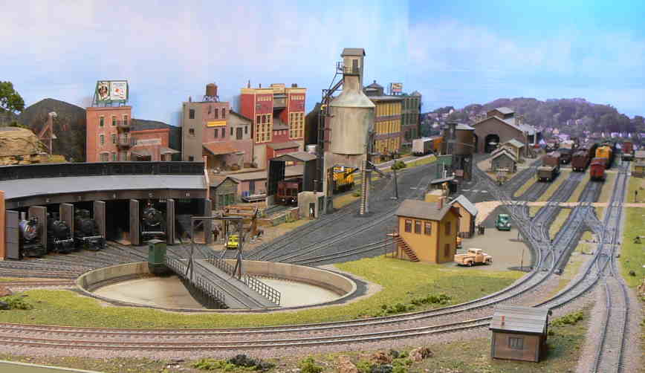
There are enough turnouts in this yard to satisfy the requirement. All ballasted. Track in the foreground is on ‘contoured roadbed’.

Slide 63
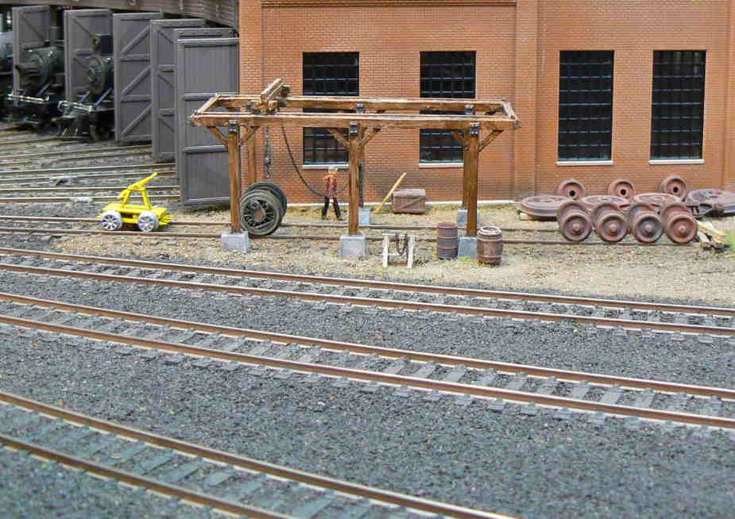
All must be properly ballasted and installed on proper roadbed. Proper roadbed is dependent on use/location. Yard trackage is not normally on ‘contoured roadbed’.
Notes:
Forcing the use of ‘contoured roadbed’ in this yard would not be ‘prototypical’.

Slide 64
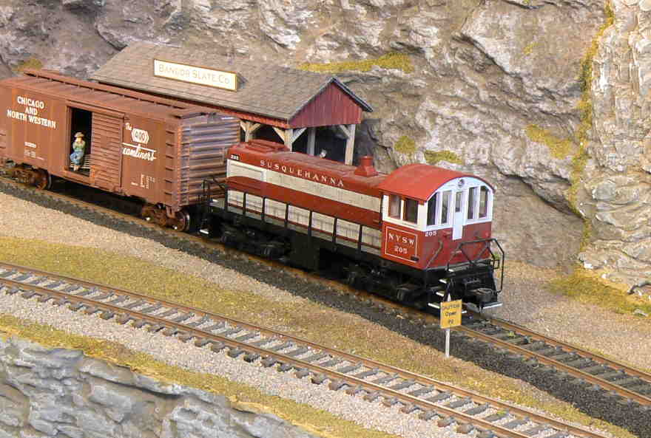
Mainline ballast and contoured roadbed in front, cinder ballast and less contoured on the slate pit siding in rear.

Slide 65
Most logging railroad trackage was right on the ground and ballasted with dirt and debris.

Slide 66
The ‘take away’ is ballasting is required, and… It should be appropriate to the setting.

Slide 67
Electrical
All installed trackage must be properly wired so that two trains can be operated simultaneously (Double-track main, single-track main with sidings, block or DCC, etc.).
This requirement can also be easier than it sounds. Notice the option for a single track main with sidings. This means that as long as you can cut power to the sidings individually, you can run one train, park it on a siding while you run another, then park it and run the first again. This meets the requirement.
Just have the member working towards the Golden Spike demonstrate this. Parking one loco while operating a second loco, running two trains in different blocks, or operating two locos with DCC will suffice.

Slide 68
Electrical, Continued
Provide one additional electrical feature such as powered turnouts, signaling, turnout indication, lighted buildings, etc.

Slide 69
Either The Caboose Marker Lights Or The Low Signal Box In This Yard Would Qualify.

Slide 70
Any Structure With Interior And/Or Exterior Lighting Will Qualify.

Slide 71
Turnout Machines Will Qualify

Slide 72
Some Final Words From the NMRA Website
Not all of these requirements need to be met on the same layout (or piece of layout).
They don't even need to be met in the same scale!
If you want to build G scale rolling stock, an N scale Model Railroad setting, and an HO scale layout for trackage and wiring, go ahead.
And remember that the structures may be separate, or one or more of them may be part of a single scene. They do not all have to be located on the 8 sq. ft. of layout that you are using for the Golden Spike.

Slide 73
Let’s Look At The Golden Spike Application Form.
Notes:
Unlike the AP Certificates, really any NMRA member can attest to the completion of the requirements for the Golden Spike Award. It is up to the Division’s AP Chair. Certainly any of you watching this clinic will be qualified to do so. We are not ‘judging models’ here. We are completing a checklist and using our judgement as to whether the rolling stock, structures, scenery, trackwork and electrical requirements are met.

Slide 75
In practice…
Visit the location (either in person or via Zoom) and have the modeler show you the Rolling Stock, 8 sq. ft. of scenery, structures, trackwork and electrical requirements.
Have the modeler explain how he/she ‘upgraded’ the Rolling Stock or Structures.
Prove that running two trains is possible.
Show the electrical components in action.
Fill out and sign the form.
Send the form to your Division AP Chair.

Slide 76
Before You Know It, You Can Earn The Golden Spike!

