Slide 1

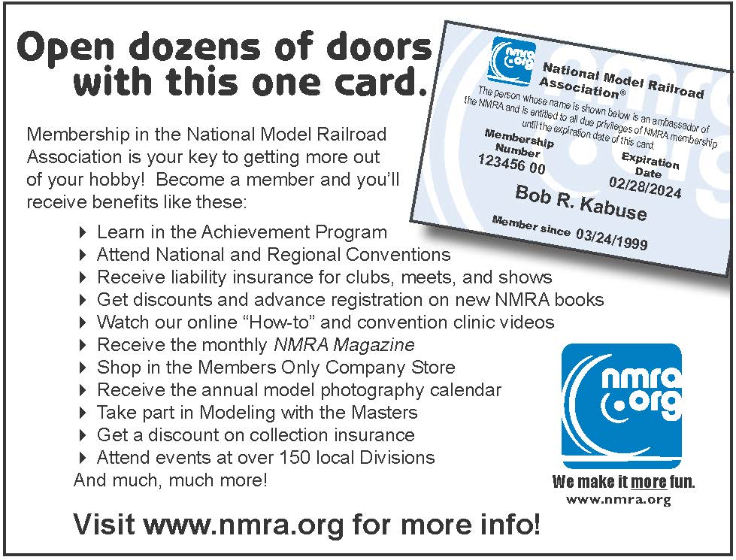

Why Join the NMRA? Why Renew?
NMRAx - It won’t always be open to the public!
Partnership Program
Achievement Program
Model Railroad Layout Directory
Conventions
Standards
Education
Publications
Insurance
OUR MEMBERS!
GatewayX Virtual Convention

Slide 2
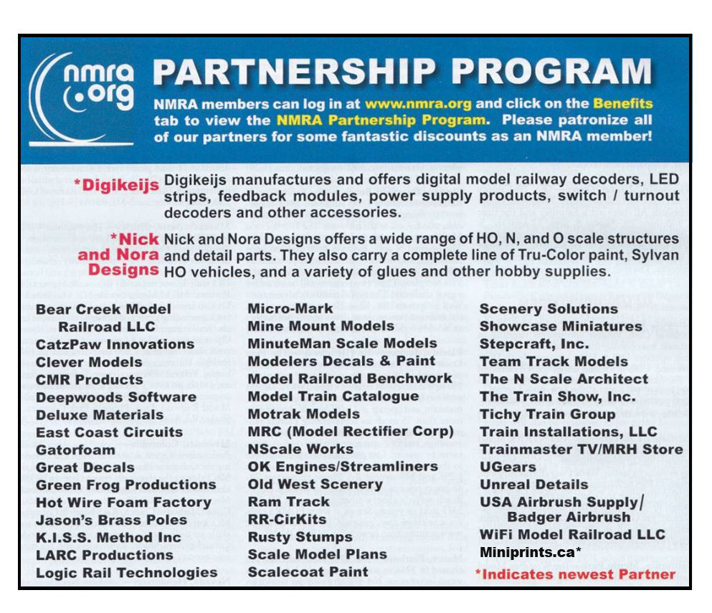
Pay For Your Membership With Discounts!
Miniprints produces craftsman-quality details 3D-printed for your model railroad layout. NMRA members receive 10% off on regular priced items and free shipping on orders of $100 USD or more. Miniprints are offered in HO, S, and O scales.
GatewayX Virtual Convention

Slide 3
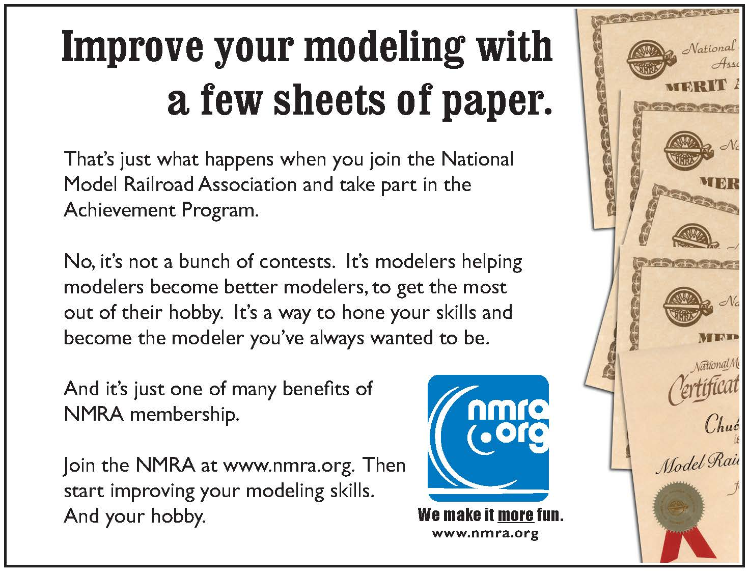
Achieve More!
Achievement Program (AP)
GatewayX Virtual Convention

Slide 4
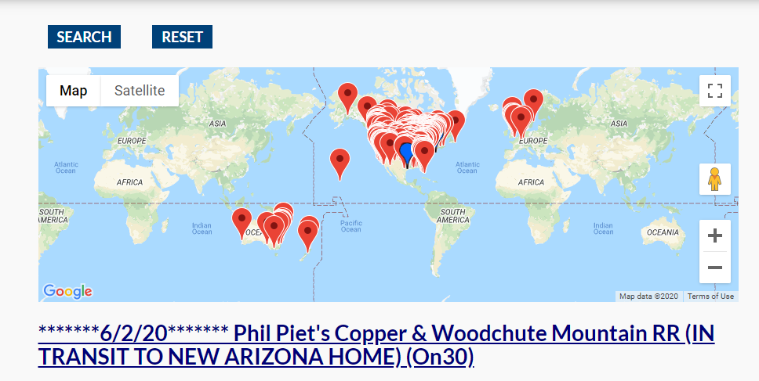
Learn and See More!
Model Railroad Layout Directory
GatewayX Virtual Convention

Slide 5
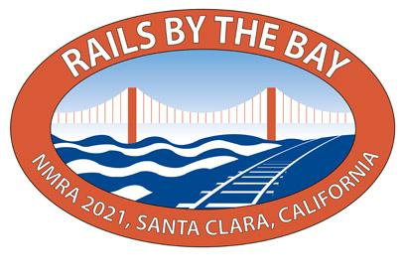
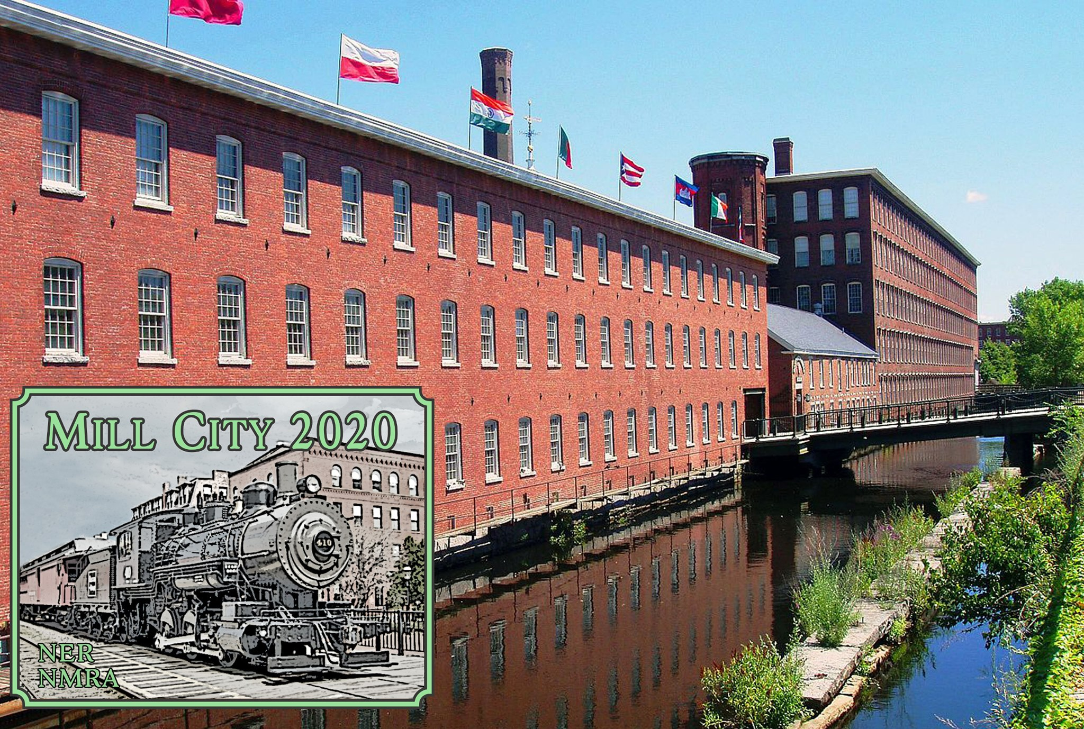
National & Regional Conventions!
Clinics, Friendships, Tours, Vendors, Celebration & More!
GatewayX Virtual Convention

Slide 6
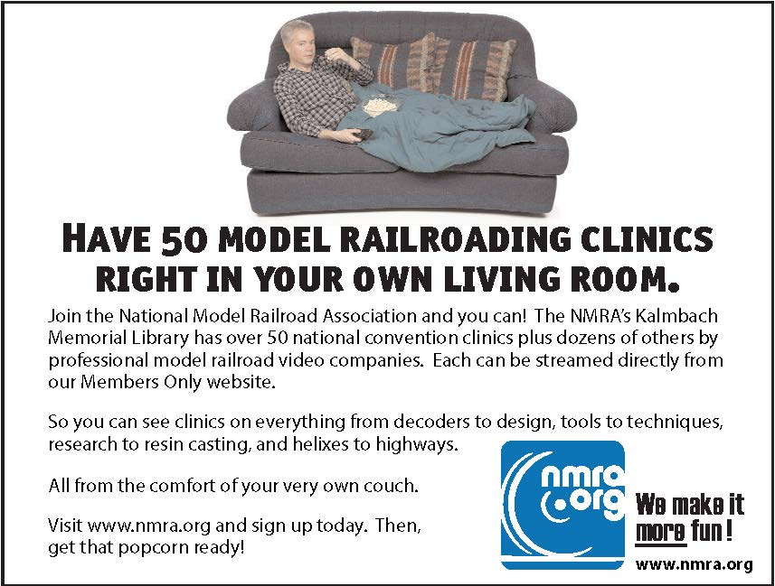

Online Resources!
GatewayX Virtual Convention

Slide 7
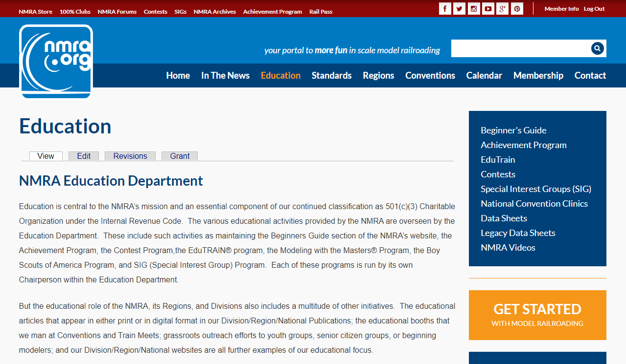
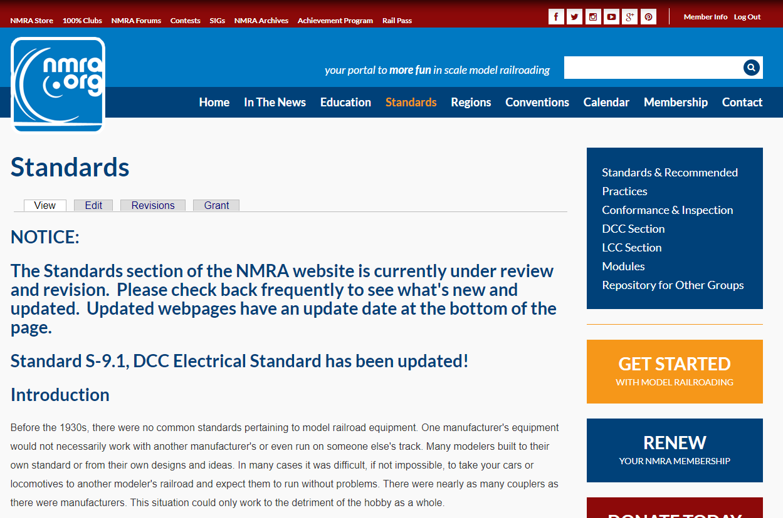
Standards & Education!
So Many Ways to Learn Right At Your Fingertips!
GatewayX Virtual Convention

Slide 8
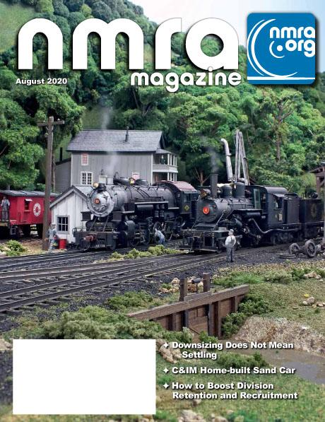



Publications!
Magazine, e-Publications, Region & Division Newsletters!
GatewayX Virtual Convention

Slide 9
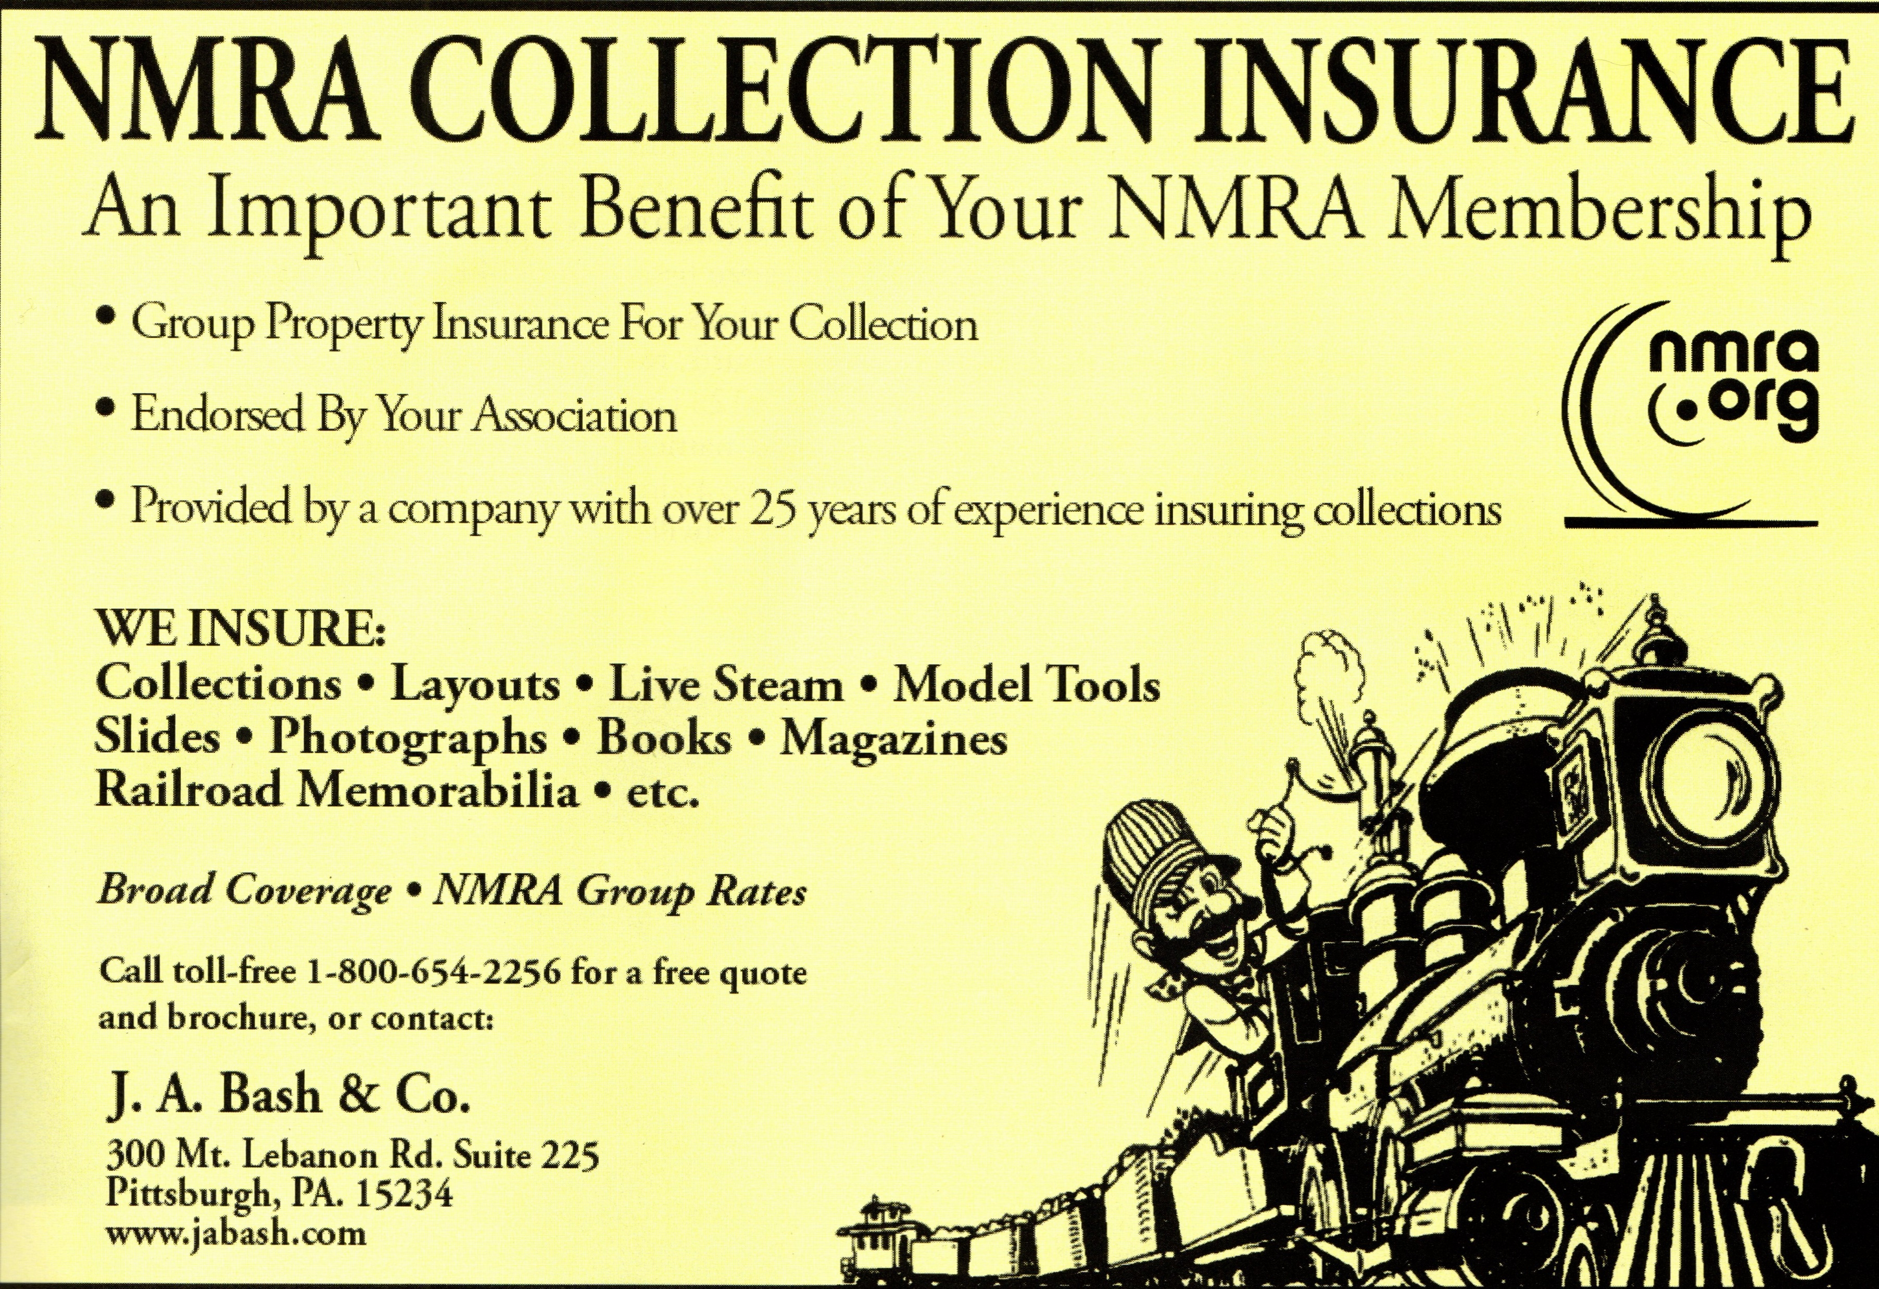
Insurance!
Protecting Your NMRA Events, 100% Clubs and Your Collection
GatewayX Virtual Convention

Slide 10
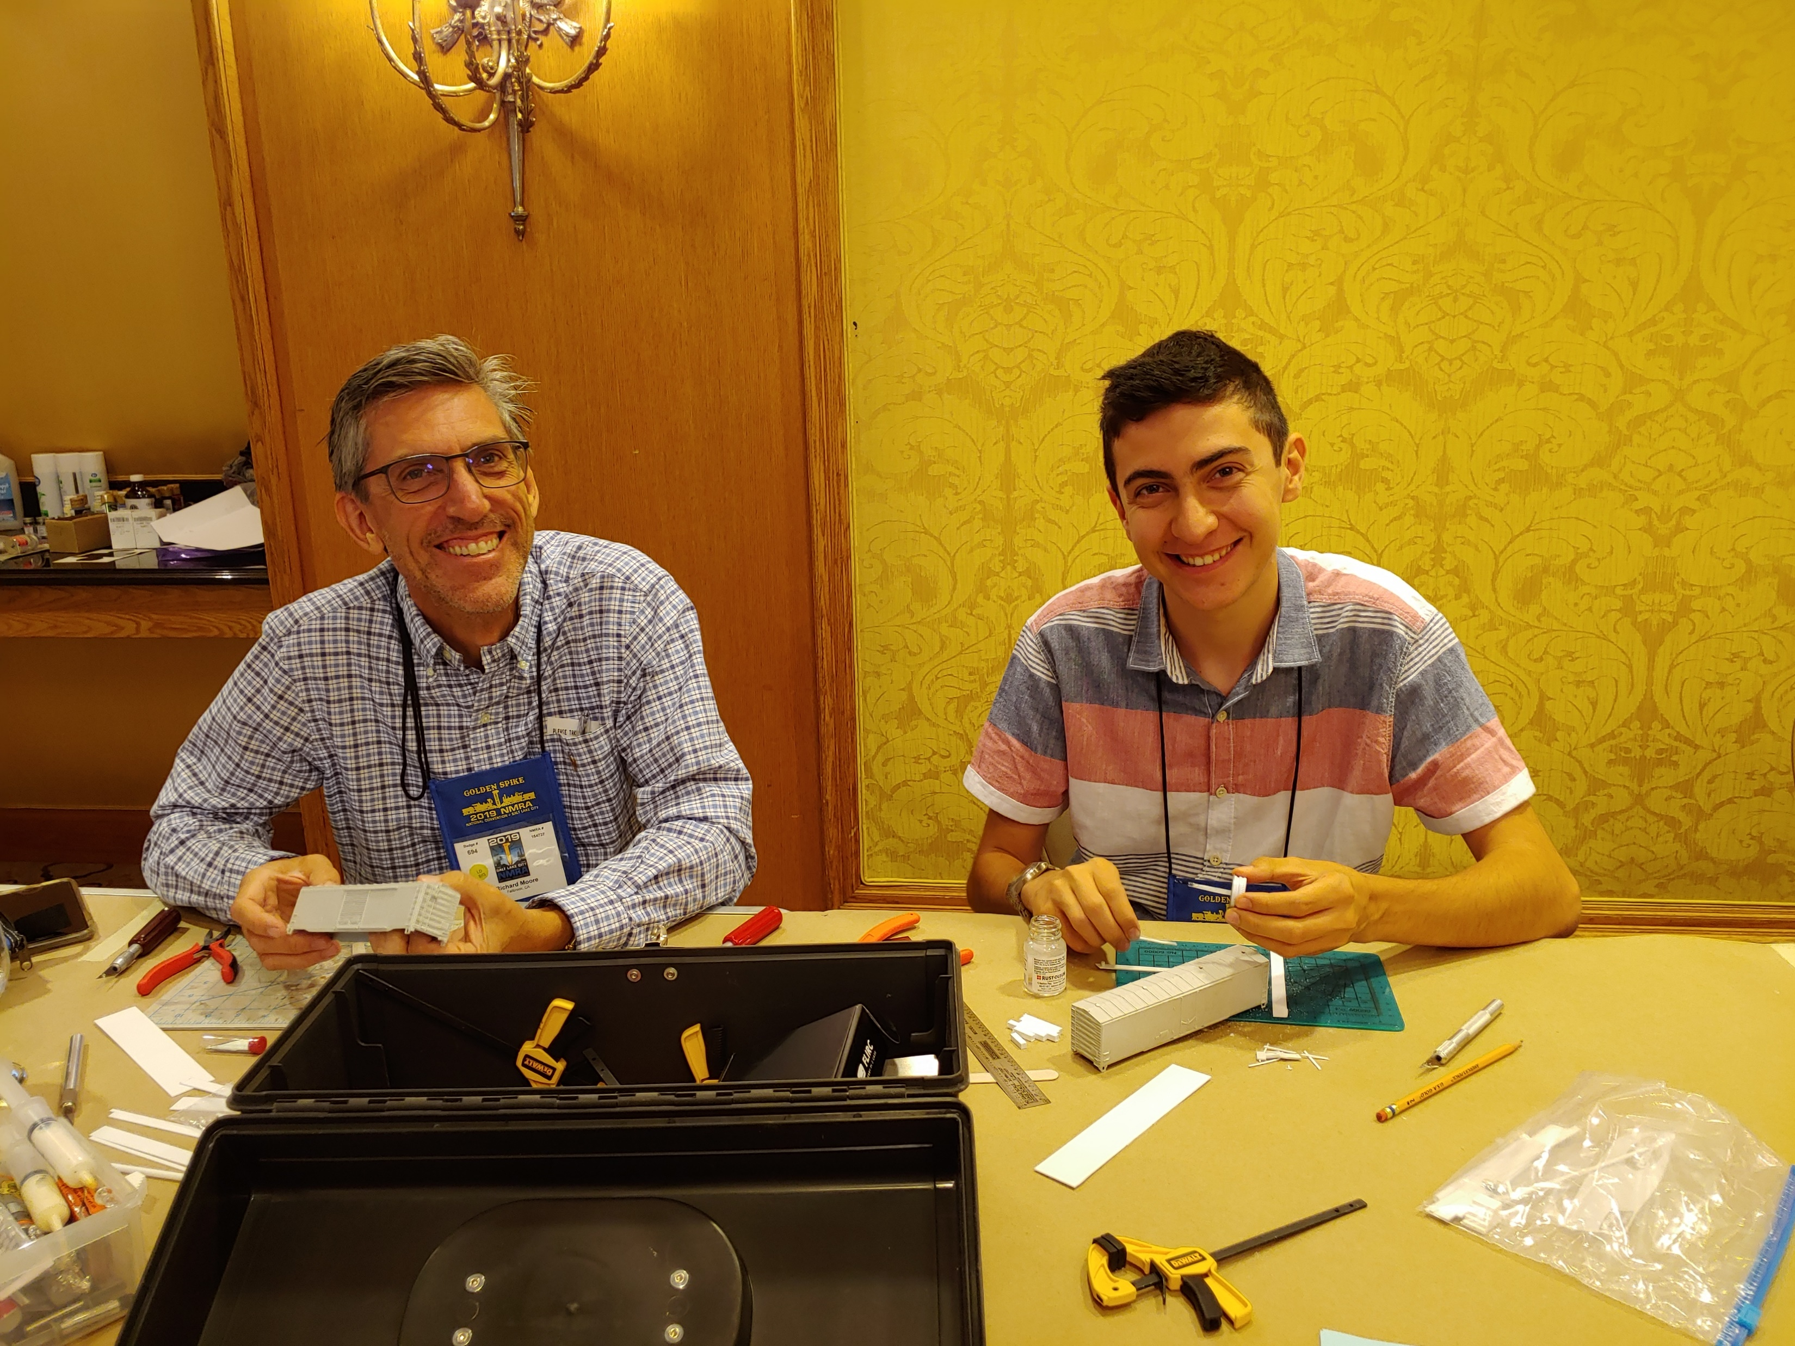
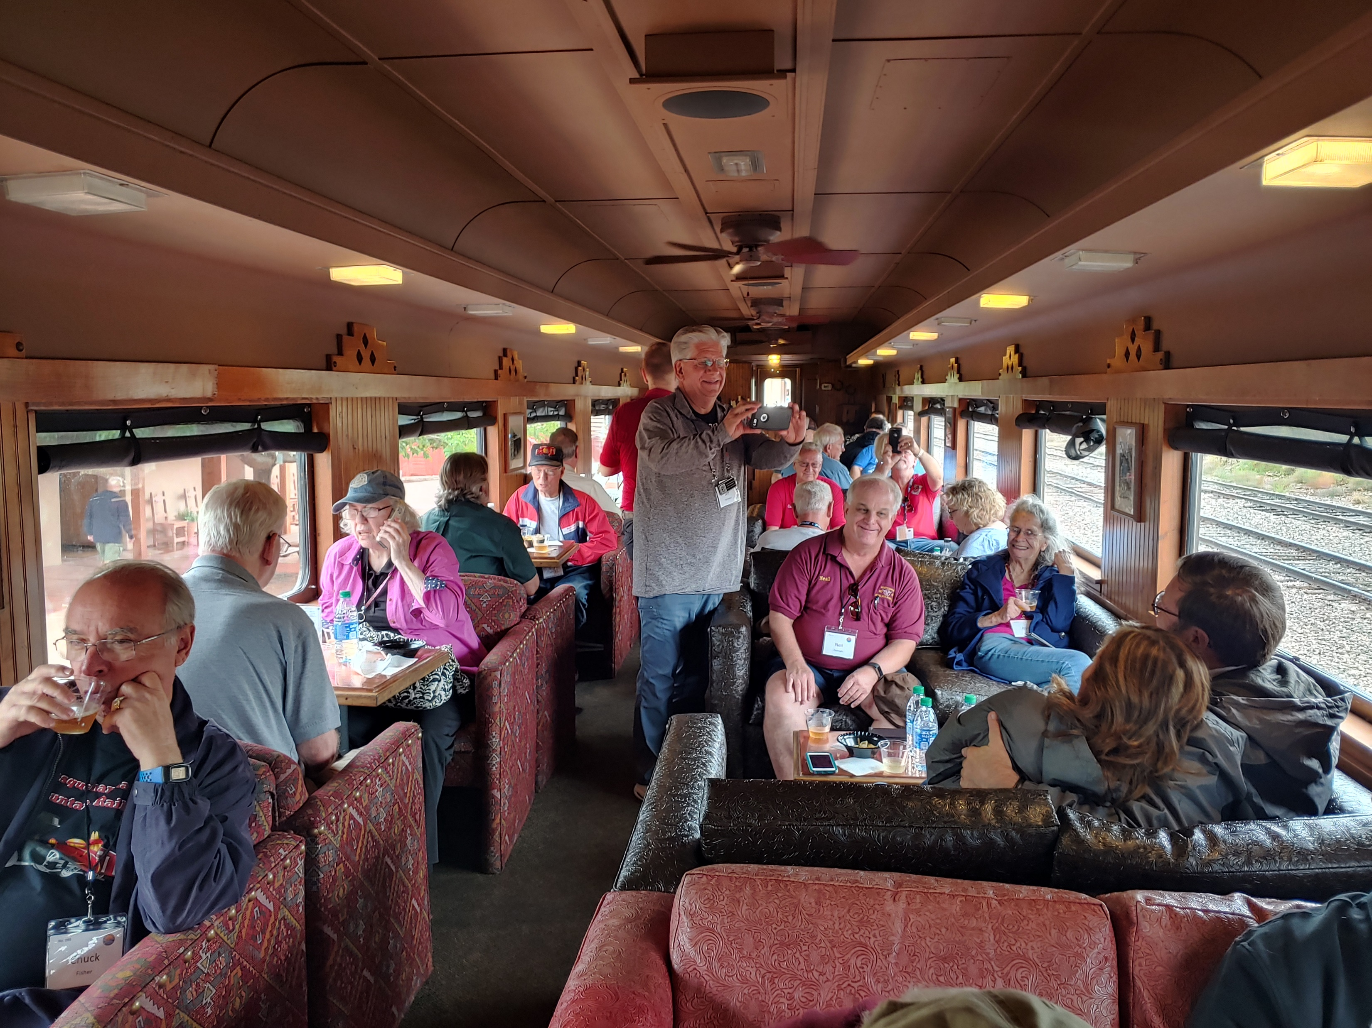
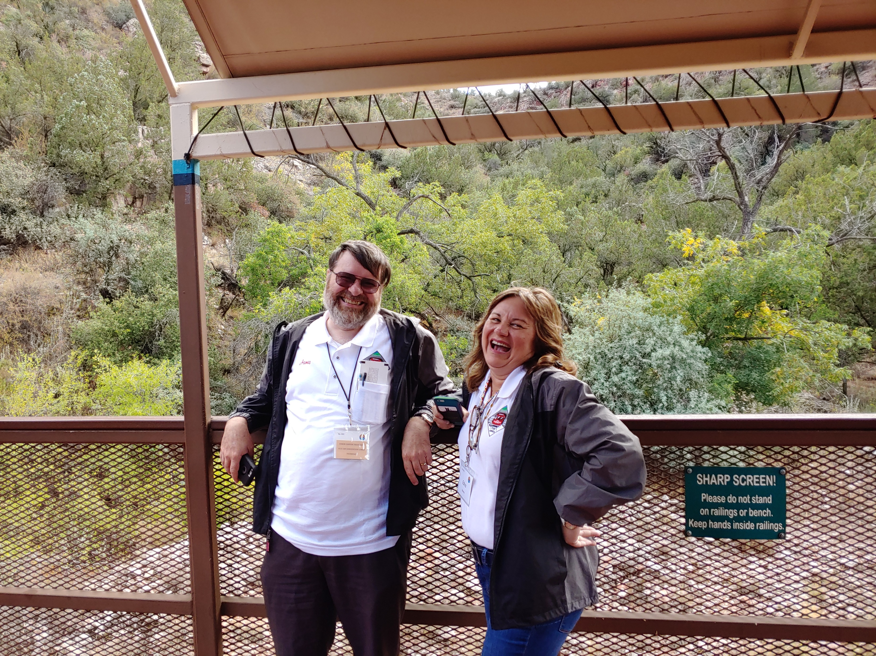
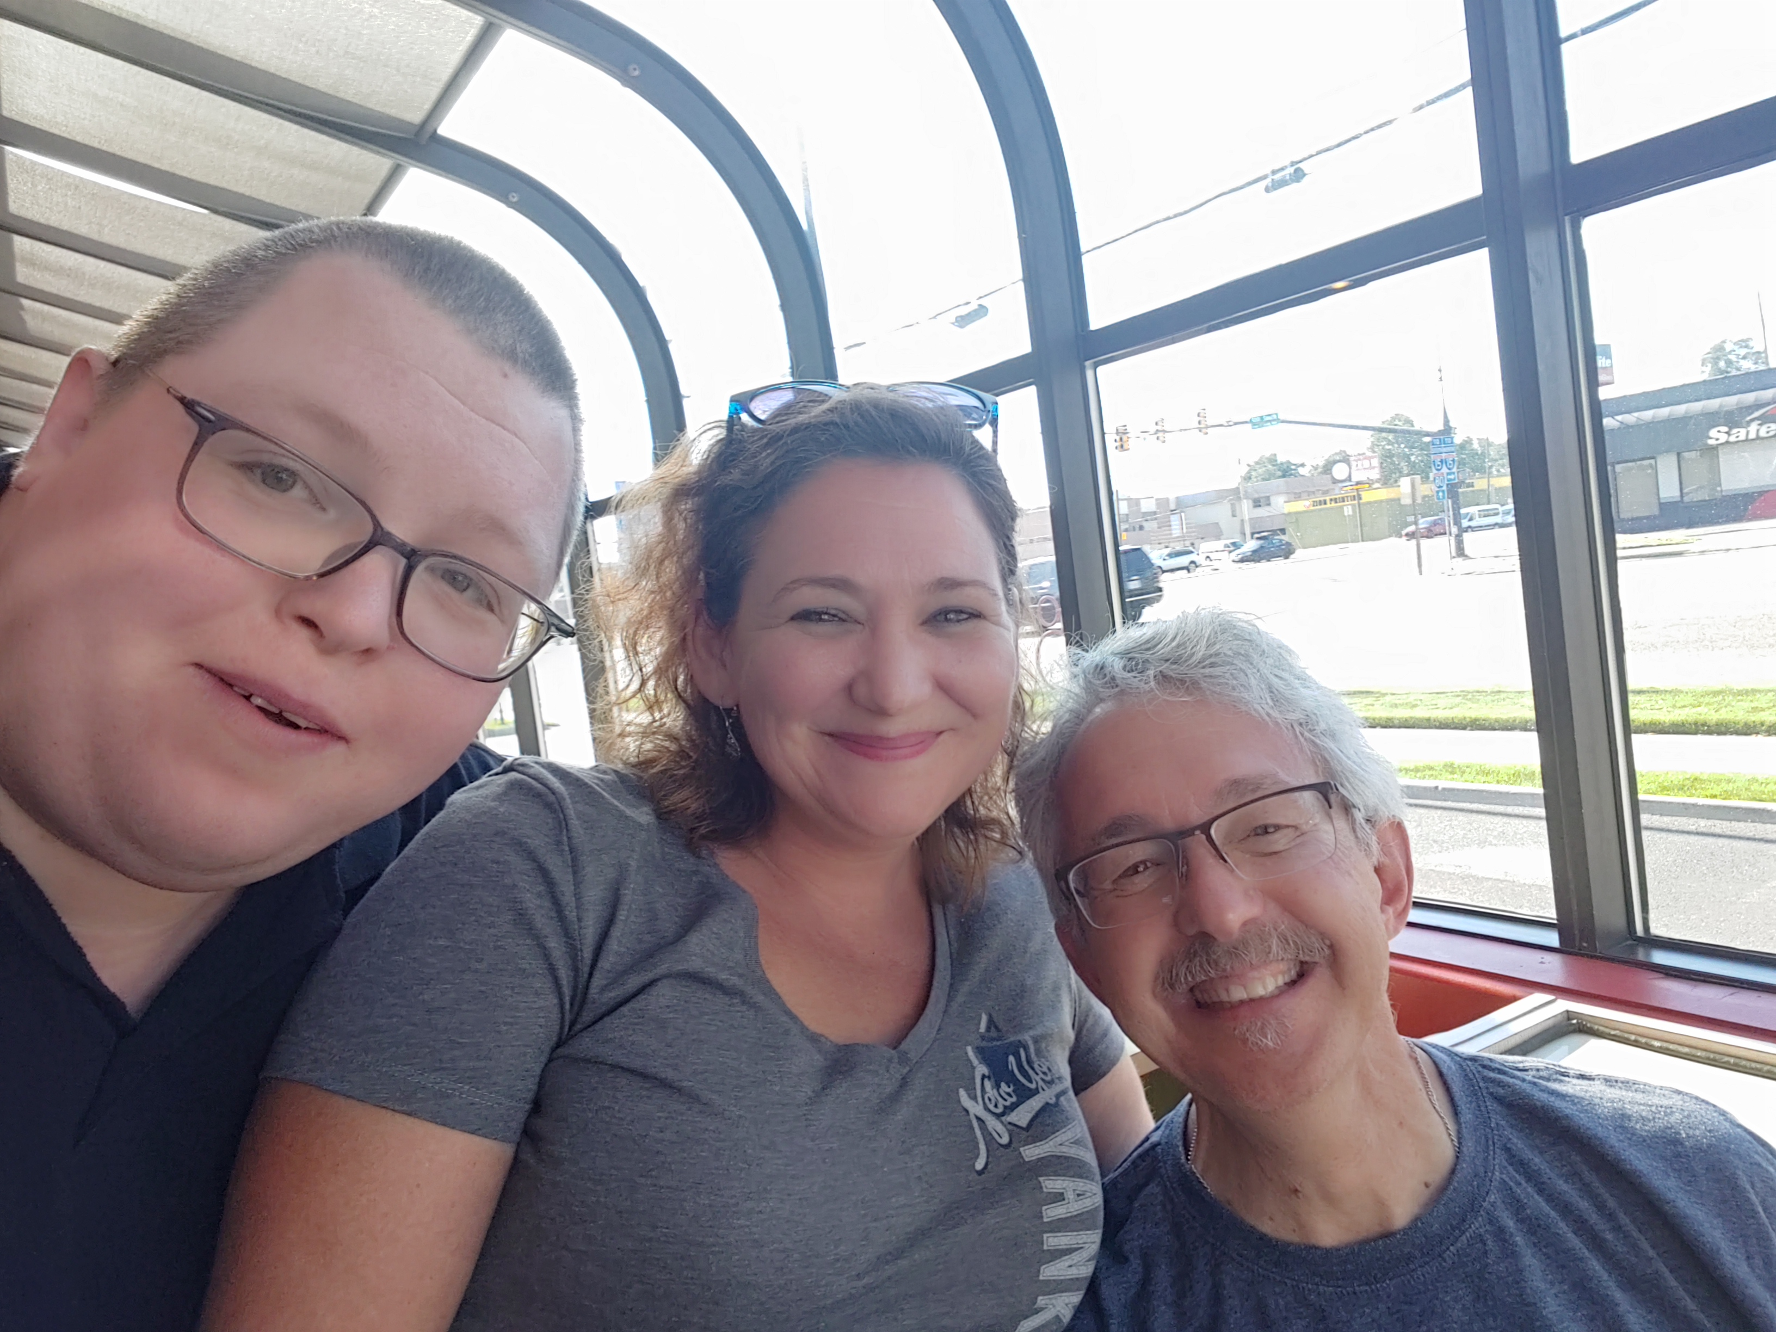
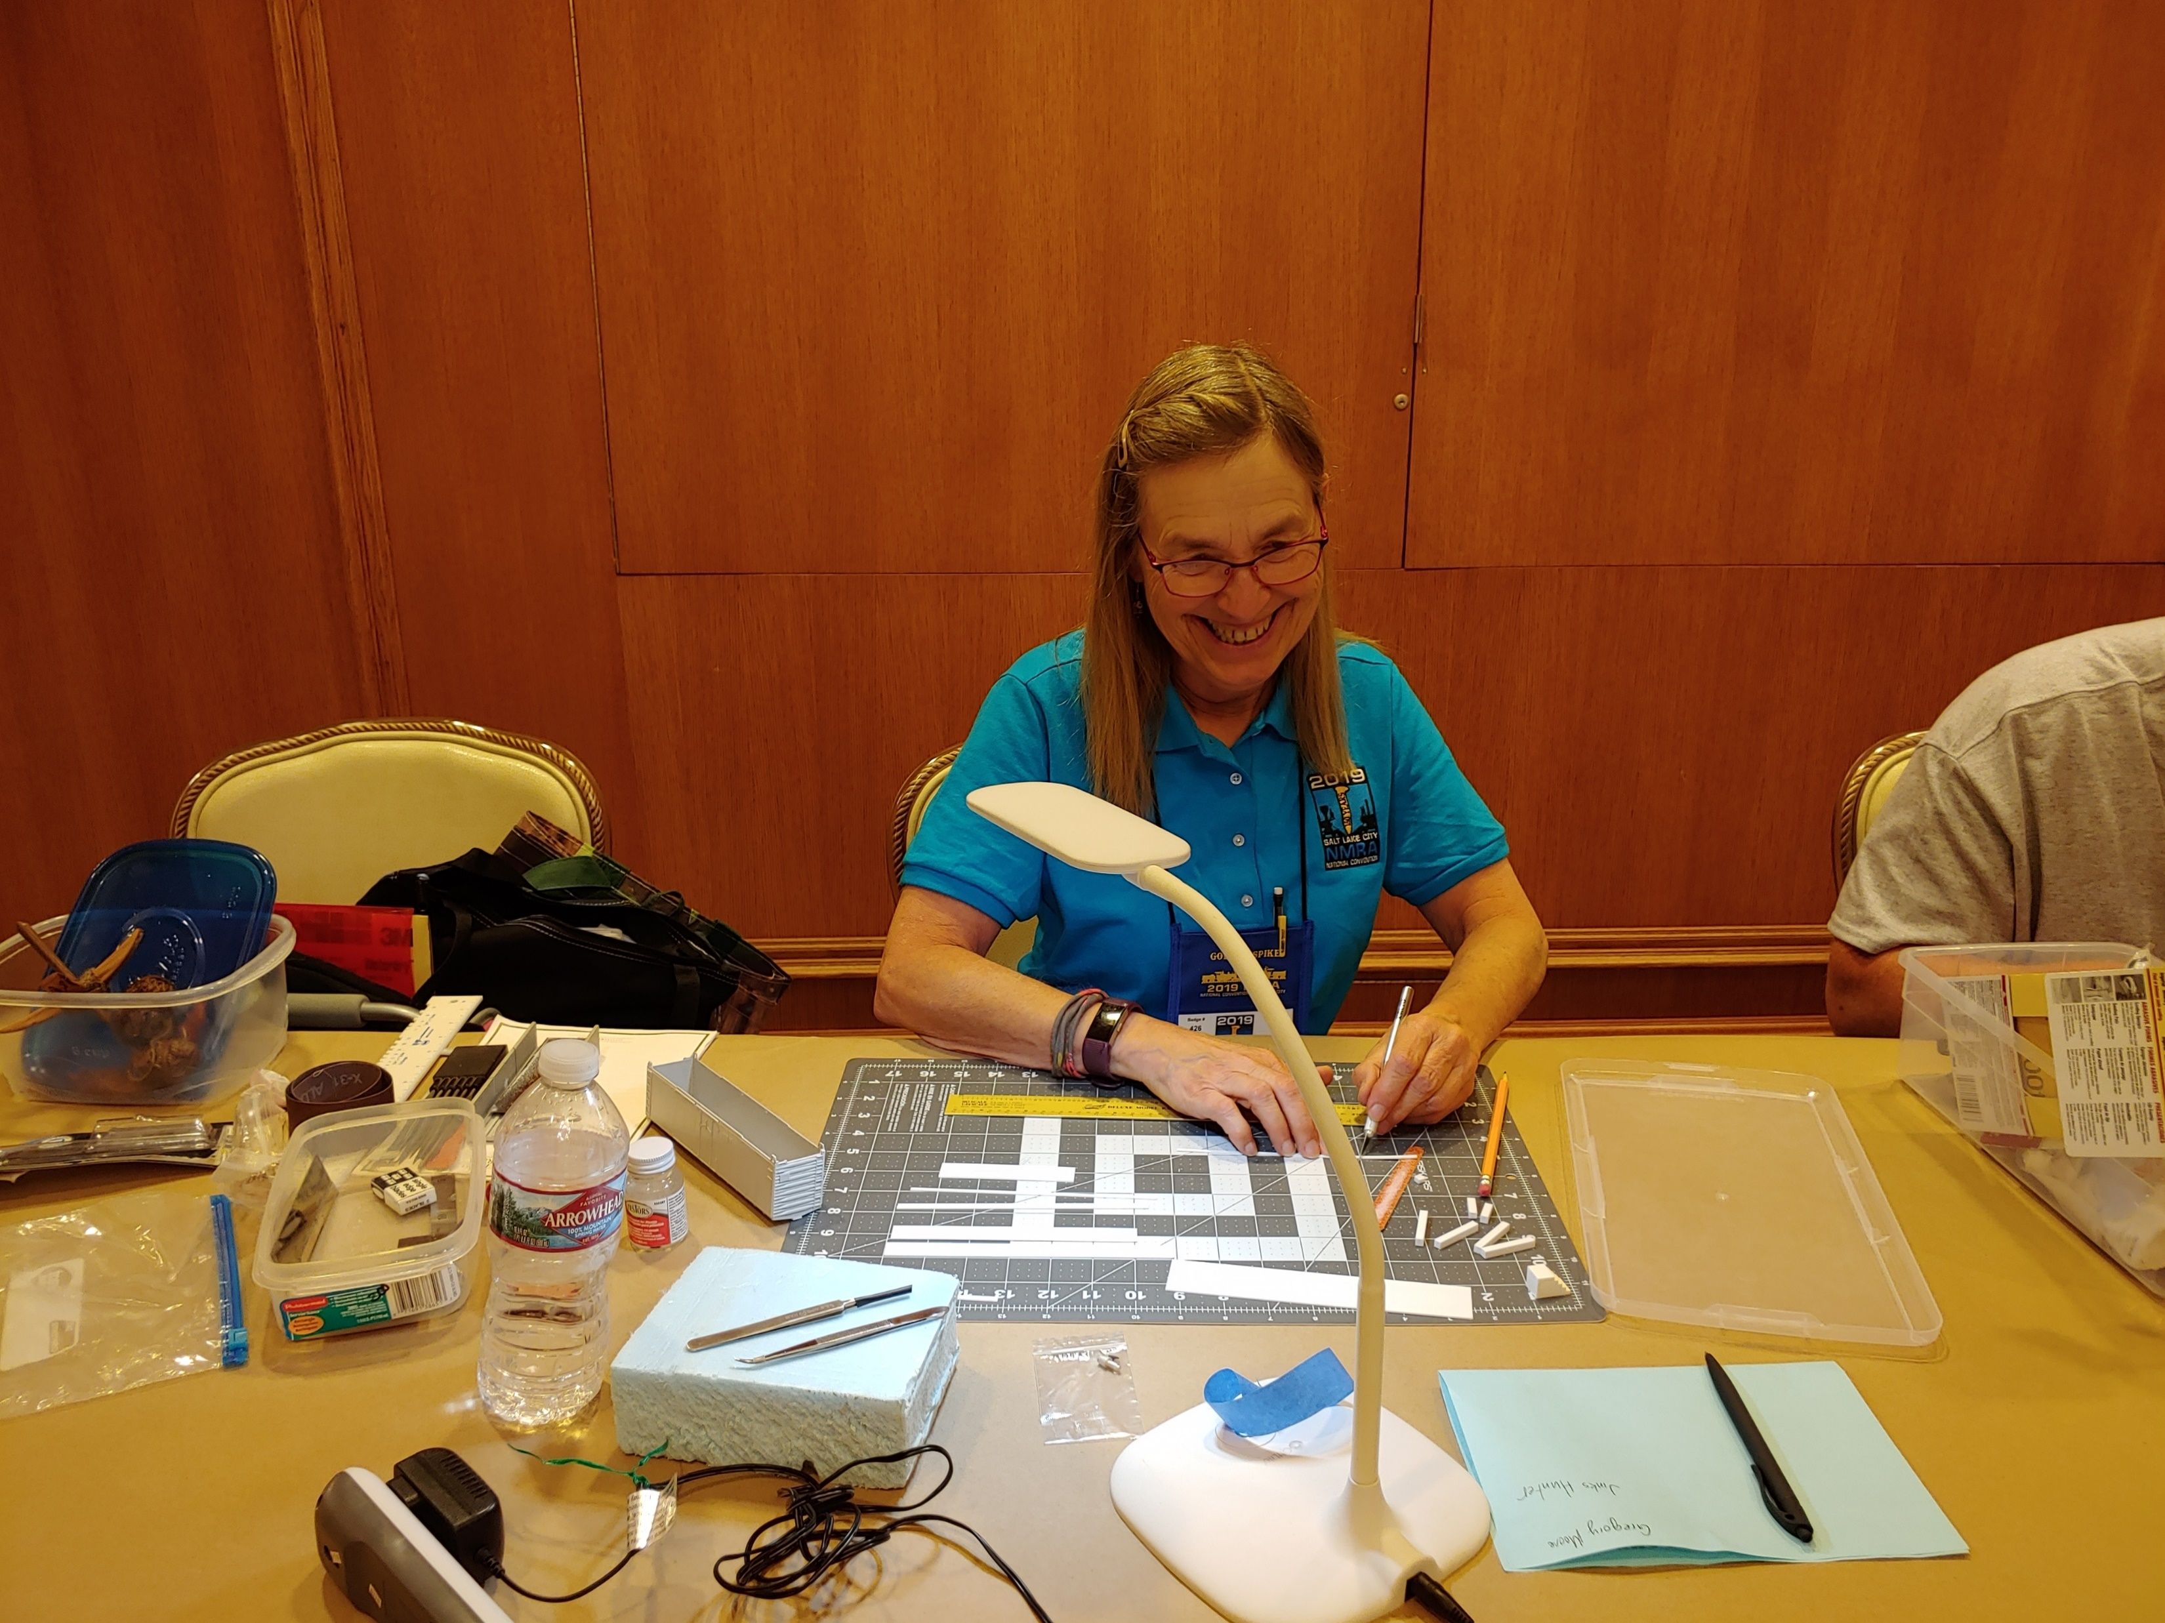
Our Members!
GatewayX Virtual Convention

